Slide 1
Hands-on Session
Xiaochen Hao, Ruifan Xu, Kexing Zhou, Youwei Xiao, Zizhang Luo, Fan Cui

Slide 2
Setup
A: Download the docker image
Please follow the handout or our website
https://ericlyun.me/tutorial-aspdac2025
B: Login our server
First, you need a SSH key
check if your SSH directory exists
win: C:\Users\<username>/.ssh
linux: $HOME/.ssh
mac: /Users/<username>/.ssh
if not exists, you need to create one
reference link
# Windows, open PowerShell
ssh-keygen -t ed25519 -C "<email>"
# Linux, open terminal
ssh-keygen -t ed25519 -C "<email>"
# Mac, open terminal
ssh-keygen -t ed25519 -C "<email>"
SSH public key can be found in <SSH>/id_ed25519.pub

Slide 3
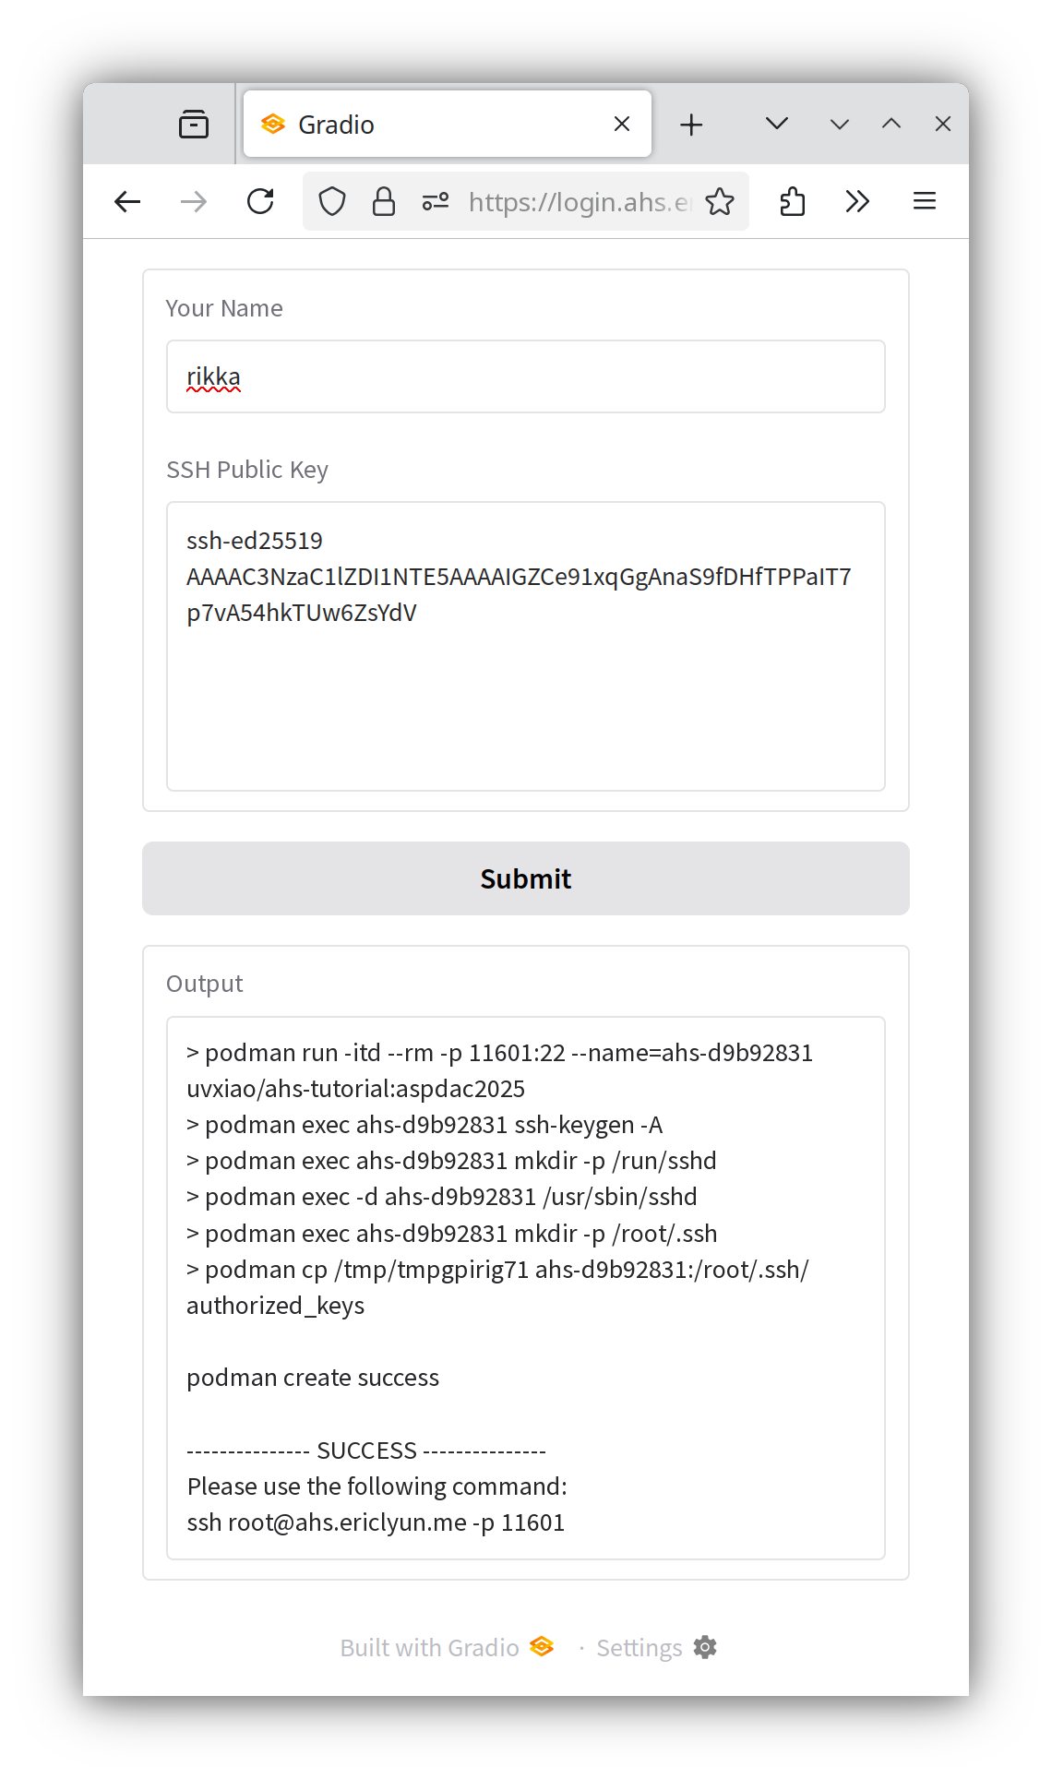
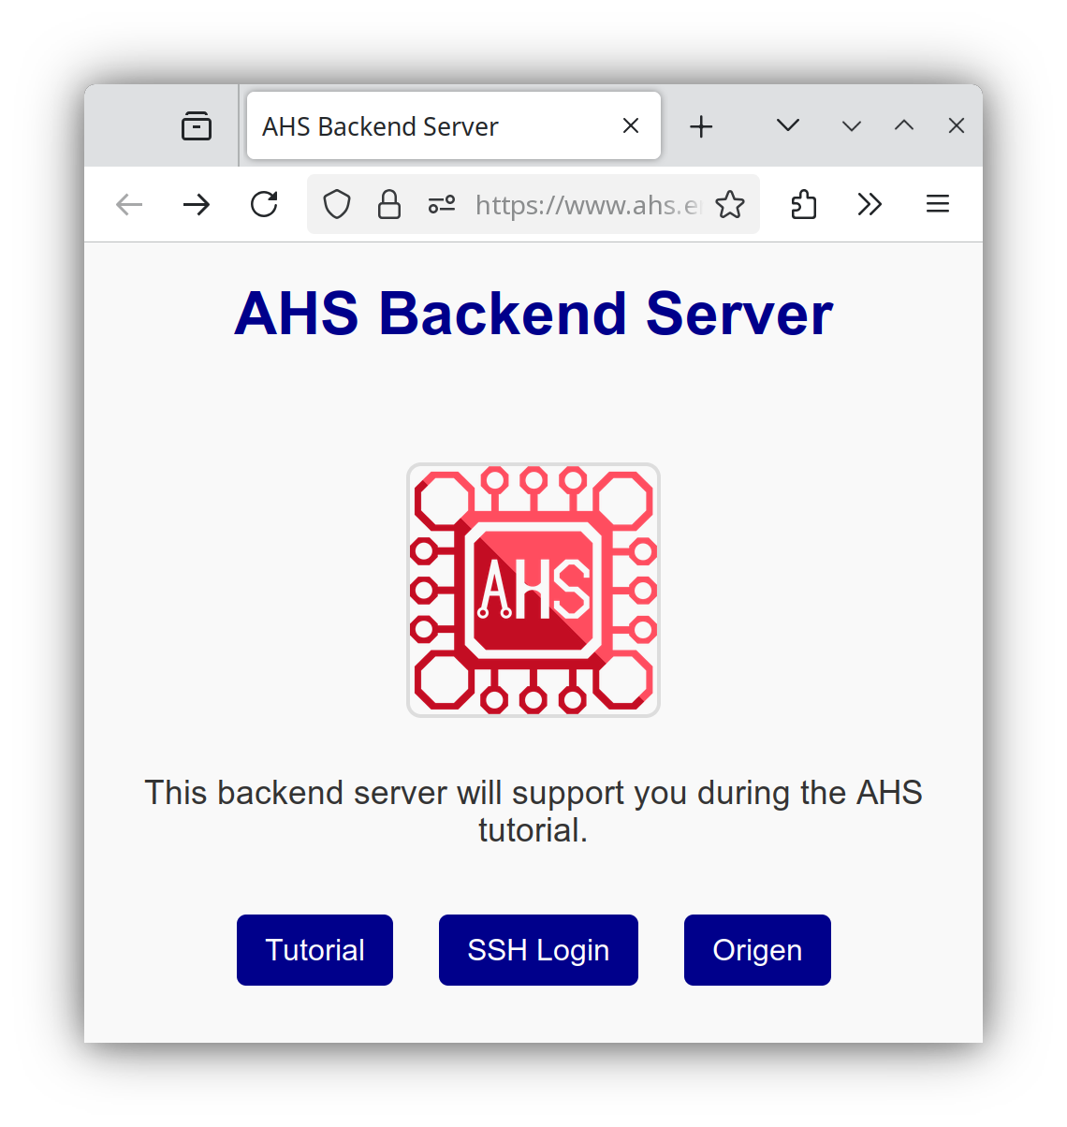
Setup
A: Download the docker image
Please follow the handout or our website
https://ericlyun.me/tutorial-aspdac2025
B: Login our server
https://ahs.ericlyun.me
User: ahs-aspdac25
Pass: AgileChipDesign
Enter your name and ssh key
Follow the output to connect

Slide 4
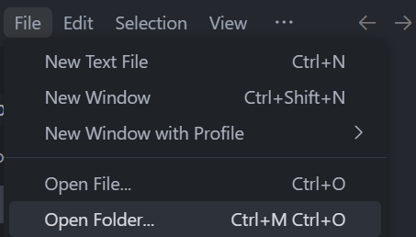
Setup
A: Download the docker image
Please follow the handout or our website
https://ericlyun.me/tutorial-aspdac2025
B: Login our server
You can use PowerShell/terminal
Or, you can use VSCode
Ctrl-Shift-P / ⇧⌘P, type Remote: Show Remote Menu
select SSH to install the extension
Ctrl-Shift-P / ⇧⌘P, type Remote-SSH: Add New SSH Host
paste “ssh root@ahs.ericlyun.me –p xxxxx”
Ctrl-Shift-P / ⇧⌘P, type Remote-SSH: Connect to Host
Ctrl-K + Ctrl-O, open /root/repos folder (optional: download rust-analyzer extension)

Slide 5
Multi-level IR and debugger for HLS
Speaker: Xiaochen Hao, Ruifan Xu
郝晓辰 徐瑞帆

Slide 6
What You Will Learn
Multi-level IR infrastructure
Learn key concepts of our DSL and IR infrastructure
Systolic array generation
Learn how to build a systolic array through dataflow representation and loop transformations
High-level synthesis and debugger
Learn hardware generation and debugging mechanism

Slide 7
Synthesis Flow
GEMM, GEMV, DOT, GBMV, SYMV…
Tensor DSL
Tensor IR
General Language
Software
IR
Control flow
Representation
SCF IR
Scheduling
Representation
ToR IR
Hardware
IR
Structural
Representation
HEC IR
Verilog

Slide 8
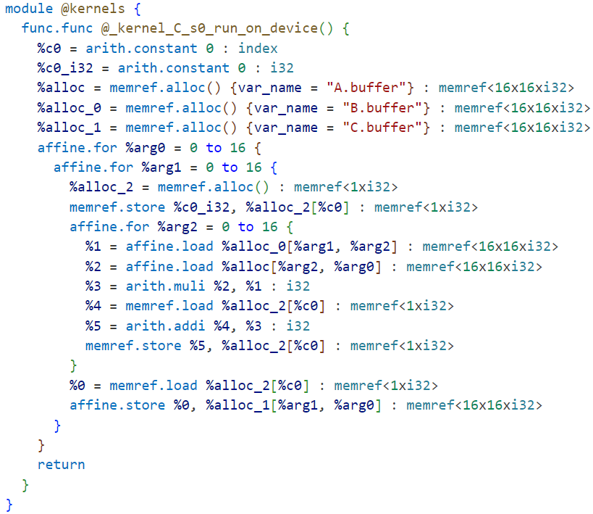
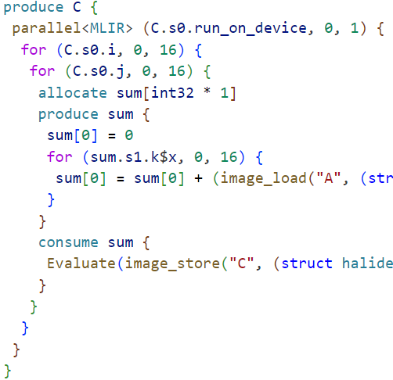
Quick Try
Run:
bash ./hls-tutorial.sh generate
cd popa/examples
Then you will get:
// Only contains algorithm definition
Func exp_0(Buffer<int> &A,
Buffer<int> &B)
// Dataflow optimization applied
Func exp_3(Buffer<int> &A,
Buffer<int> &B)
Tensor IR file
(exp_[0-3]])
SCF IR file
(mm_[0-3].mlir)
Specification
(tutorial.cpp)

Slide 9
Domain-specific Language (DSL)
Let us look at:
Declare input buffers
Buffer<float> A(N, M), B(S, N);
Var i("i"), j("j");
RDom k(0, N, "k");
Func C(Place::Device);
C(j, i) = sum(A(k, i) * B(j, k));
C.set_bounds(i, 0, M,
j, 0, S);
Target target = get_host_target();
target.set_feature(Target::MLIR);
C.compile_to_device(“SCF_vanilla.mlir”, {}, target);
Declare loop variables (k is an reduction loop)
Define computations in a functional expression
Specify loop schedules
(How to optimize the computations)
Let us target MLIR
Specification
(Func exp_0,
popa/examples/tutorial.cpp)

Slide 10
IR Lowering
for (C.s0.i, 0, 16) {
for (C.s0.j, 0, 16) {
allocate sum[float32 * 1]
produce sum {
sum[0] = 0.000000f
for (sum.s1.k$x, 0, 16) {
sum[0] = sum[0] + (image_load("A",…) *image_load("B",…))
}
}
consume sum {
image_store("C", …, sum[0])
}
}
}
Loop structure:
tiling, unrolling, vectorization…
affine.for %arg0 = 0 to 16 {
affine.for %arg1 = 0 to 16 {
%alloc_2 = memref.alloc()
memref.store %c0_i32, %alloc_2[%c0]
affine.for %arg2 = 0 to 16 {
%1 = affine.load %alloc_0[%arg1, %arg2]
%2 = affine.load %alloc[%arg2, %arg0]
%3 = arith.muli %2, %1
%4 = memref.load %alloc_2[%c0]
%5 = arith.addi %4, %3
memref.store %5, %alloc_2[%c0]
}
%0 = memref.load %alloc_2[%c0]
affine.store %0, %alloc_1[%arg1, %arg0]
}
}
Statement: storage flattening, loop invariant hoisting…
Tensor IR File
(popa/examples/exp_0)
Lowering
Lowered SCF IR File
(popa/examples/mm_0.mlir)

Slide 11
Systolic Array
How to build a systolic array?
Dataflow
Software World
Temporal instruction pipeline
Load-store data access…
Hardware World
Spatial processing elements
Direct data propagation…
Loop Transformation
Dataflow Representation
matmul
Uniform Recurrence Equation (URE)
Space-time Transform (STT)
Tiling
Vectorization
Systolic Array
$$C_{ij}=sum(A_{ik}B_{kj})$$
Dataflow definition and mapping
Resource efficiency
(Func exp_[0-3], popa/examples/tutorial.cpp)

Slide 12
A dataflow of matrix multiply
Legend:
ijk
Iteration indexed by i, j, k
c_{ij} (0)
b_{kj}
a_{ik} is not related with j. So reuse a_{ik} along dimension j
b_{kj} is not related with i. So reuse b_{kj} along dimension i
Reduce c_{ij} (from 0) along dimension k
ij0
0jk
…
…
ij(k-1)
(i-1)jk
…
a_{ik}
i0k
i(j-1)k
ijk

Slide 13
How to express the dataflow
Each loop iteration is associated with unique variables: $X_{ijk},Y_{ijk},Z_{ijk}$
c_{ij} (0)
b_{kj}
X_{ijk} = a_{ik} if j=0, X_{i(j-1)k} otherwise
ij0
0jk
Y_{0jk}
UREs
Y_{ijk} = b_{kj} if i=0, Y_{(i-1)jk} otherwise
…
Z_{ij0}
Z_{ijk} = 0 if k=0, Z_{ij(k-1)}+X_{ijk} Y_{ijk} otherwise
ij(k-1)
(i-1)jk
Final result: Z_{ijk} if k reaches its max
Z_{ij(k-1)}
Y_{(i-1)jk}
…
a_{ik}
i0k
i(j-1)k
ijk
X_{ijk}
X_{i0k}
X_{i(j-1)k}
Y_{ijk}
Z_{ijk}

Slide 14
How to express the dataflow
Each loop iteration is associated with unique variables: $X_{ijk},Y_{ijk},Z_{ijk}$
X_{ijk} = a_{ik} if j=0, X_{i(j-1)k} otherwise
Uniform Recurrence Equations (UREs):
Recursive relationship
Uniform dependency
Dynamic single assignment form
UREs
Y_{ijk} = b_{kj} if i=0, Y_{(i-1)jk} otherwise
Z_{ijk} = 0 if k=0, Z_{ij(k-1)}+X_{ijk} Y_{ijk} otherwise
Final result: Z_{ijk} if k reaches its max
Specification
X(k, j, i) = select(j == 0, A(k, i), X(k, j-1, i));
Y(k, j, i) = select(i == 0, B(j, k), Y(k, j, i-1));
Z(k, j, i) = select(k == 0, 0, Z(k-1, j, i)) + X(k, j, i) * Y(k, j, i);
C(j, i) = select(k == K-1, Z(k, j, i));
select(condition, x, y) = (condition ? x : y)

Slide 15
How to express the dataflow
Forming loop nest
Each URE is defined within a separate iteration space
Group them together under the same loop nest
Initial IR
X_{ijk} = a_{ik} if j=0, X_{i(j-1)k} otherwise
for (i = 0; i < I; i++)
for (j = 0; j < J; j++)
for (k = 0; k < K; k++)
X(k, j, i) = …
Y(k, j, i) = …
Z(k, j, i) = …
C( j, i) = …
UREs
Y_{ijk} = b_{kj} if i=0, Y_{(i-1)jk} otherwise
Z_{ijk} = 0 if k=0, Z_{ij(k-1)}+X_{ijk} Y_{ijk} otherwise
Specification
…
X.merge_ures(Y, Z, C)
i
Dataflow mapping
j
PE
PE
Put the UREs Y, Z, C in order, into the loop nest of X
PE
PE

Slide 16
Dataflow Mapping
Space-time Transform
Mapping loop instances onto spatial PEs
Schedule instance execution in a temporal order
Map each point to a new space of $(x,y,t)$
$$STT\left(\left[\begin{aligned}i \\ j \\ k\end{aligned}\right]\right)=\left[\begin{aligned}x \\ y \\ t\end{aligned}\right]$$
Space
Time
$$i$$
$$j$$
$$k$$
$$P=\left[\begin{matrix}1 & 0 & 0 \\ 0 & 1 & 0\end{matrix}\right]$$
$$x=i$$
Projection matrix:
$$y=j$$
Map point $(i,j,k)$ to $(x,y)$
$$i$$
$$j$$
$$k$$
Scheduling vector：
$${\vec{s}}^{T}=\left(\begin{matrix}1 & 1 & 1\end{matrix}\right)$$
$$t=k+j+i$$
Schedule point $(i,j,k)$ at time $t$

Slide 17
Dataflow Mapping
Space-time Transform
Mapping loop instances onto spatial PEs
Schedule instance execution in a temporal order
PE(0,0) t=0:
Map a₀₀->X₀₀₀, b₀₀->Y₀₀₀, 0->Z₀₀₀
PE(0,0) t=1:
Map a₀₁->X₀₀₁, b₁₀->Y₀₀₁, Z₀₀₀->Z₀₀₁
Map X₀₀₀->X₀₁₀ (reuse of a₀₀ )
Map Y₀₀₀->Y₁₀₀ (reuse of b₀₀ )
PE(0,0) t=2:
Map a₀₂->X₀₀₂, b₂₀->Y₀₀₂, Z₀₀₁->Z₀₀₂
Map X₀₀₁->X₀₁₁ (reuse of a₀₁ )
Map Y₀₀₁->Y₁₀₁ (reuse of b₁₀ )
b₁₀
b₁₁
b₀₀
b₀₁
b₀₂
b₂₀
a₀₀
a₀₂
a₀₁
(0, 0)
(0, 1)
(0, 2)
k=2
k=1
k=0
a₁₁
a₁₀
(1, 0)
(1, 1)
(1, 2)
k=1
k=0
a₂₀
(2, 0)
(2, 1)
(2, 2)
k=0
PE Array

Slide 18
Dataflow Mapping
Specify space-time transform
Unscheduled STT:
…
X.space_time_transform(j, i)
Specify only space loops
Specification
Scheduled STT:
X.space_time_transform({k, j, i}
{t, y, x},
{1, 1, 1,
0, 1, 0,
0, 0, 1})
Source loops
Destination loops
Projection matrix
Scheduling vector
Specification (Equivalent version)

Slide 19
Dataflow Mapping
Exploring dataflow designs using space-time transform
Keeping input A stationary
space_time_transform(k, i)
Keeping input B stationary
space_time_transform(k, j)
b₀₀
b₁₀
b₂₀
a₀₀
a₀₁
a₀₂
c₀₀
(0, 0)
(0, 1)
(0, 2)
c₀₀
(0, 0)
(0, 1)
(0, 2)
c₁₀
(1, 0)
(1, 1)
(1, 2)
c₁₀
(1, 0)
(1, 1)
(1, 2)
c₂₀
(2, 0)
(2, 1)
(2, 2)
c₂₀
(2, 0)
(2, 1)
(2, 2)
PE Array
PE Array

Slide 20
Compilation
IR transformation and code generation
…
realize X.shreg[0, 16], [0, 16] {
unrolled for (X.s0.i, 0, 16) {
unrolled for (X.s0.j, 0, 16) {
pipelined for (X.s0.k, 0, 16) {
write_shift_reg("X.shreg", X.s0.j, X.s0.i,
select(X.s0.j == 0, image_load("A",…),
read_shift_reg("X.shreg", X.s0.j-1, X.s0.i)))
write_shift_reg("Y.shreg",…)
write_shift_reg("Z.shreg",…)
}
image_store("C", …)
}
}
}
…
%alloc_4 = memref.alloc() : memref<16x16xi32>
affine.for %arg0 = 0 to 16 {
affine.for %arg1 = 0 to 16 {
affine.for %arg2 = 0 to 16 {
%1 = affine.load %alloc_4[%arg1 - 1, %arg0]
%2 = affine.load %alloc[%arg2, %arg0]
%5 = arith.select %4, %2, %1
affine.store %5, %alloc_4[%arg1, %arg0]
…
} {pipeline = 1}
%0 = affine.load %alloc_2[%arg1, %arg0]
affine.store %0, %alloc_1[%arg1, %arg0]
} {unroll = 0}
} {unroll = 0}
Loop annotation
Mapped Dataflow
Tensor IR
Lowered SCF IR

Slide 21
Tiling
Scaling to large matrices
Partition the output matrix into tiles
Compute tile-by-tile using a systolic array
PE
PE
PE
PE
Restructure the loops
X.space_time_transform(jj, ii)
Specification
for (X.s0.i, 0, 8) {
for (X.s0.j, 0, 8) {
pipelined (X.s0.k, 0, 16) {
unrolled (X.s0.ii, 0, 2) {
unrolled (X.s0.jj, 0, 2) {
write_shift_reg("X.shreg", …, read_shift_reg("X.shreg", X.s0.jj + -1, X.s0.ii))
write_shift_reg("Y.shreg", …, read_shift_reg("Y.shreg", X.s0.jj, X.s0.ii + -1))
…
}}}}}
Time loop
Space loop
Tensor IR

Slide 22
Tiling
Array Partitioning
Splitting an array into small partitions
Partitions can be accessed in parallel
Matrix B
$$j=0$$
2
1
3
$$k$$
Annotation based on loop unrolling
$$k$$
$$i=0$$
Matrix A
(0, 0)
(0, 1)
%alloc = memref.alloc() {
partition_cyclic_array = [1],
partition_dim_array = [1],
partition_factor_array = [2]}
2
Partitioning dimension
$i$ cyclically
1
(1, 0)
(1, 1)
Matrix B
3
%alloc_0 = memref.alloc() {
partition_cyclic_array = [1],
partition_dim_array = [0],
partition_factor_array = [2]}
PE Array
Partitioning dimension
$j$ cyclically
Matrix A
SCF IR

Slide 23
Vectorization
Enabling more parallelism
Duplicating compute units in each PE
Improve resource efficiency
Matrix B
$$j=0$$
2
1
3
$$k$$
Restructure the loops
$$k$$
$$i=0$$
(0, 0)
(0, 1)
X.vectorization(kk)
Specification
2
for (X.s0.i, 0, 8)
for (X.s0.j, 0, 8)
pipelined (X.s0.k, 0, 16)
unrolled (X.s0.ii, 0, 2)
unrolled (X.s0.jj, 0, 2)
unrolled (X.s0.kk, 0, 2)
…
1
(1, 0)
(1, 1)
3
PE Array
Matrix A
a₀
b₀
a₁
b₁
Tensor IR
×
×
Vector Unit
+

Slide 24
Quick Try
Run:
./hls-tutorial run vanilla
./hls-tutorial run optimized
Then you will get:
 | Vanilla | Optimized
Cycle | 15411 | 2203
The optimized version achieves a 7X speedup compared to the vanilla version

Slide 25
Synthesis Flow
GEMM, GEMV, DOT, GBMV, SYMV…
Tensor DSL
Tensor IR
General Language
Software
IR
Control flow
Representation
SCF IR
Scheduling
Representation
ToR IR
Hardware
IR
Structural
Representation
HEC IR
Verilog

Slide 26
ToR IR
Provide a high-level control flow for hardware information
Two parts, time graph and functional operations
tor.topo (0 to 7) {
tor.from 0 to 1 "seq:1"
tor.from 1 to 2 "seq:1"
tor.from 2 to 3 "call"
tor.from 1 to 4 "seq:2"
tor.from 3, 4 to 5 "if"
tor.from 5 to 6 "seq:1"
tor.from 0 to 7 "for"
}
2
@f
3
1
if
0
1
1
2
4
if
5
1
6
loop
7

Slide 27
Time Graph
Four types of nodes including normal, call, if and loop
sequential
#cycles
call
@callee
2
@f
3
1
if
$$⋯$$
if
0
1
1
2
4
if
5
1
6
sequential
loop
7
if
sequential
$$⋯$$
back
sequential
$$⋯$$
loop

Slide 28
Functional operations
Algorithmic specification with high-level information
Bind each operation to the element of the time graph
tor.for %i = %c0 to %c10 step %c1 {
%m = tor.load %mask[%i] on (0 to 1)
%a = tor.if %m then {
%x = tor.addi %i %c1 on (1 to 2)
%y = tor.subi %i %c1 on (1 to 2)
%fx = tor.call @f(%x, %y) on (2 to 3)
tor.yield %fx
} else {
%ii = tor.muli %i %i on (1 to 4)
tor.yield %ii
} on (1 to 5)
tor.store %a to %A[%i] on (5 to 6)
} on (0 to 7)
2
@f
3
1
if
0
1
1
2
4
if
5
1
6
loop
7

Slide 29
Functional operations
Algorithmic specification with high-level information
Bind each operation to the element of the time graph
tor.for %i = %c0 to %c10 step %c1 {
%m = tor.load %mask[%i] on (0 to 1)
%a = tor.if %m then {
%x = tor.addi %i %c1 on (1 to 2)
%y = tor.subi %i %c1 on (1 to 2)
%fx = tor.call @f(%x, %y) on (2 to 3)
tor.yield %fx
} else {
%ii = tor.muli %i %i on (1 to 4)
tor.yield %ii
} on (1 to 5)
tor.store %a to %A[%i] on (5 to 6)
} on (0 to 7)
2
@f
3
1
if
0
1
1
2
4
if
5
1
6
loop
7

Slide 30
Functional operations
Algorithmic specification with high-level information
Bind each operation to the element of the time graph
tor.for %i = %c0 to %c10 step %c1 {
%m = tor.load %mask[%i] on (0 to 1)
%a = tor.if %m then {
%x = tor.addi %i %c1 on (1 to 2)
%y = tor.subi %i %c1 on (1 to 2)
%fx = tor.call @f(%x, %y) on (2 to 3)
tor.yield %fx
} else {
%ii = tor.muli %i %i on (1 to 4)
tor.yield %ii
} on (1 to 5)
tor.store %a to %A[%i] on (5 to 6)
} on (0 to 7)
2
@f
3
1
if
0
1
1
2
4
if
5
1
6
loop
7

Slide 31
Supplementary information
Timing information like latency is attached to time graph
tor.topo (0 to 7) {
tor.from 0 to 1 "seq:1"
tor.from 1 to 2 "seq:1"
tor.from 2 to 3 "call"
tor.from 1 to 4 "seq:2"
tor.from 3, 4 to 5 "if"
tor.from 5 to 6 "seq:1"
tor.from 0 to 7 "for"
}

Slide 32
Supplementary information
Timing information like latency is attached to time graph
Three scheduling manners are supported in ToR IR
Static, pipeline and dynamic
tor.topo (0 to 7) {
tor.from 0 to 1 "seq:1"
tor.from 1 to 2 "seq:1"
tor.from 2 to 3 "call"
tor.from 1 to 4 "seq:2"
tor.from 3, 4 to 5 "if"
tor.from 5 to 6 "seq:1"
tor.from 0 to 7 "pipeline-for:1"
}
2
@f
3
1
if
0
1
1
2
4
if
5
1
6
loop
7
tor.for {...} on (0 to 7) {pipeline, II = 1}

Slide 33
Supplementary information
Timing information like latency is attached to time graph
Three scheduling manners are supported in ToR IR
Static, pipeline and dynamic
tor.topo (0 to 7) {
tor.from 0 to 1 "dynamic"
tor.from 1 to 2 "dynamic"
tor.from 2 to 3 "dynamic-call"
tor.from 1 to 4 "dynamic"
tor.from 3, 4 to 5 "dynamic-if"
tor.from 5 to 6 "dynamic"
tor.from 0 to 7 "dynamic-for"
}
2
@f
3
if
0
1
4
if
5
6
loop
7

Slide 34
Quick Try
Run:
cd hector
cp $(which hector-opt) ./hector
bash examples/hls_script.sh hector examples
Then you will get several directories:
examples/tor-raw/
examples/tor-split/
examples/hec/
examples/chisel/

Slide 35
SCF to TOR Compilation
cat examples/tor-raw/gemm_ncubed_kernel.mlir
tor.timegraph (0 to 15){
tor.succ 1 : [0 : i32] [{type = “static”}]
tor.succ 2 : [1 : i32] [{type = "static"}]
tor.succ 3 : [2 : i32] [{type = "static"}]
tor.succ 4 : [3 : i32] [{type = "static:1"}]
tor.succ 5 : [4 : i32] [{type = "static"}]
tor.succ 6 : [5 : i32] [{type = "static"}]
tor.succ 7 : [6 : i32] [{type = "static:1"}]
tor.succ 8 : [7 : i32] [{type = "static:1"}]
tor.succ 9 : [8 : i32] [{type = "static:9"}]
tor.succ 10 : [9 : i32] [{type = "static:13"}]
tor.succ 11 : [5 : i32] [{II = 14 : i32, pipeline = 1 : i32, type = "static-for"}]
tor.succ 12 : [11 : i32] [{type = "static"}]
tor.succ 13 : [12 : i32] [{type = "static:1"}]
tor.succ 14 : [2 : i32] [{type = "static-for"}]
tor.succ 15 : [1 : i32] [{type = "static-for"}]
}

Slide 36
SCF to TOR Compilation
tor.for %arg0 = (%c0_i32 : i32) to (%c62_i32 : i32) step (%c1_i32 : i32)
on (1 to 14) {
tor.for %arg1 = (%c0_i32 : i32) to (%c62_i32 : i32) step (%c1_i32 : i32)
on (2 to 13) {
%3 = arith.shli %arg0, %c6_i32 {endtime = 4 : i32, starttime = 3 : i32} : i32
%4 = tor.for %arg2 = (%c0_i32 : i32) to (%c62_i32 : i32) step (%c1_i32 : i32)
on (5 to 10) iter_args(%arg3 = %cst) -> (f64) {
%6 = arith.shli %arg2, %c6_i32 {endtime = 7 : i32, starttime = 6 : i32} : i32
%7 = tor.addi %3 %arg2 on (6 to 7) : (i32, i32) -> i32
%8 = tor.load %0[%7] on (7 to 8) : !tor.memref<4096xf64, [], "r">[i32]
%9 = tor.addi %6 %arg1 on (6 to 7) : (i32, i32) -> i32
%10 = tor.load %1[%9] on (7 to 8) : !tor.memref<4096xf64, [], "r">[i32]
%11 = tor.mulf %8 %10 on (8 to 9) : f64
%12 = tor.addf %arg3 %11 on (9 to 10) : f64
tor.yield %12 : f64
} {II = 14 : i32, pipeline = 1 : i32}
%5 = tor.addi %3 %arg1 on (12 to 13) : (i32, i32) -> i32
tor.store %4 to %2[%5] on (12 to 13) : (f64, !tor.memref<4096xf64, [], "w">[i32])
}
}

Slide 37
HEC IR
Adopt an allocate-assign mechanism
hec.assign %m.lhs = %0
hec.assign %m.rhs = %1
//Case #1:
hec.assign %i = %m.res
//Case #2:
hec.assign %i = %2
%m.lhs, rhs, res = primitive "mul_integer"
%sub.a, b, c = instance "sub" @mod
%i = wire "i"
lhs
*
a
mod
lhs=%0
res
c
i
*
rhs
b
res
rhs=%1
Mux
i
%2

Slide 38
HEC IR
Three component styles corresponding to ToR
State Transition Graph, Pipeline stages, Handshake
component @STG {
// allocations
stateset {
state @Idle {
// assigns
transition {
goto @Start if %cond
}
}
state @Start {
transition {
goto @Done
}
}
state @Done {
transition {
goto @Idle
}
}
}
} {style = "stg"}
Idle
Done
Start

Slide 39
HEC IR
Three component styles corresponding to ToR
State Transition Graph, Pipeline stages, Handshake
component @STG {
// allocations
stateset {
state @Idle {
// assigns
transition {
goto @Start if %cond
}
}
state @Start {
transition {
goto @Done
}
}
state @Done {
transition {
goto @Idle
}
}
}
} {style = "stg"}
Idle
Done
Start

Slide 40
HEC IR
Three component styles corresponding to ToR
State Transition Graph, Pipeline stages, Handshake
component @Pipe {
// allocations
stageset {
stage @stage0 {
// assigns
}
stage @stage1 {
// assigns
hec.assign %add2.lhs = %add0.res
hec.assign %add2.rhs = %add1.res
}
stage @stage2 {
// assigns
}
stage @stage3 {
// assigns
deliver %mul1.res, %add3.res
}
}
} {"pipeline",II=1}
Stage 0
+
+
*
Stage 1
+
-
Stage 2
*
+

Slide 41
HEC IR
Three component styles corresponding to ToR
State Transition Graph, Pipeline stages, Handshake
Latency-insensitive Design
component @Handshake (%in1,%in2,%out){
// allocations
%shift.in,res = primitive . "shift"
%add.lhs,rhs,res = primitive . "addi"
// elastic units
%merge.i1,i2,o = primitive . "merge"
%fork.i,o1,o2 = primitive . "fork"
graph {
assign %fork.i = %in1
assign %shift.in = %fork.o1
assign %add.lhs = %in2
assign %add.rhs = %f.o2
assign %merge.i1 = %shift.res
assign %merge.i2 = %add.res
assign %out = %merge.o
}
}{"handshake"}
Fork
Shift
Merge
Add
valid
ready
data
Handshake Protocol

Slide 42
TOR to HEC Compilation
cat examples/hec/gemm_ncubed_kernel.mlir
hec.stage @s1{
%1 = hec.shift_left %r_5_i_1.reg %c6_i32 {dump = "comb_0"} : i32
hec.assign %r_8_2.reg = %1 : i32 -> i32
%2 = hec.addi %r_3_1.reg %r_5_i_1.reg {dump = "comb_1"} : (i32, i32) -> i32
hec.assign %r_9_2.reg = %2 : i32 -> i32
%3 = hec.addi %1 %r_4_1.reg {dump = "comb_2"} : (i32, i32) -> i32
hec.assign %r_10_2.reg = %3 : i32 -> i32
hec.assign %r_5_i_2.reg = %r_5_i_1.reg : i32 -> i32
hec.assign %r_6_2.reg = %r_6_1.reg : f64 -> f64
}
hec.stage @s2{
hec.assign %mem_global_0.addr = %r_9_2.reg : i32 -> i12
hec.enable %mem_global_0.r_en : i1
hec.assign %mem_global_1.addr = %r_10_2.reg : i32 -> i12
hec.enable %mem_global_1.r_en : i1
hec.assign %r_5_i_3.reg = %r_5_i_2.reg : i32 -> i32
hec.assign %r_6_3.reg = %r_6_2.reg : f64 -> f64
hec.assign %r_9_3.reg = %r_9_2.reg : i32 -> i32
hec.assign %r_10_3.reg = %r_10_2.reg : i32 -> i32
}

Slide 43
TOR to HEC Compilation
cat examples/hec/gemm_ncubed_kernel.mlir
hec.component @outline_0(%arg0: i32,%arg1: i32,%arg2: i32,%arg3: i32,%arg4: i32,%arg5: i1) -> (%arg6: f64,%arg7: i1)
{interface="naked", style="pipeline"}{
%r_13_13.reg = hec.primitive "r_13_13" is "register" : f64
%mulf_outline_0_0.operand0, operand1, result = hec.primitive
"mulf_outline_0_0" is "mul_float" : f64, f64, f64
}
hec.component @main(%arg0: i1) -> (%arg1: i1)
{interface="naked", style="STG"}{
%r_main_0.reg = hec.primitive “r_main_0” is “register” : i1
%r_main_1.reg = hec.primitive "r_main_1" is "register" : i1
%r_main_2.reg = hec.primitive "r_main_2" is "register" : i32
%r_main_3.reg = hec.primitive "r_main_3" is "register" : i32
%outline_0_0.in0, in1, in2, in3, in4, go, out0, done = hec.instance
"outline_0_0" @outline_0 : i32, i32, i32, i32, i32, i1, f64, i1
}

Slide 44
RTL Generation
cat examples/chisel/gemm_ncubed_kernel.scala
class main extends MultiIOModule {
val done = IO(Output(Bool()))
done := 0.U
val outline_0_0 = Module(new outline_0)
val var8 = IO(Output(UInt(64.W)))
object State extends ChiselEnum { val s0, s1, s1_entry, s2, s2_entry, s3, s4, s5, s5_wait, s6, s7, s8, s9, s10 = Value }
val state = RegInit(State.s0)
switch (state) {
is (State.s1) {
val var90 = 0.U <= 62.U
var76 := var90
val var91 = !var90
state := State.s2;
when (var91.asBool()) { state := State.s10; }
}
is (State.s10) { done := 1.U }
}
}

Slide 45
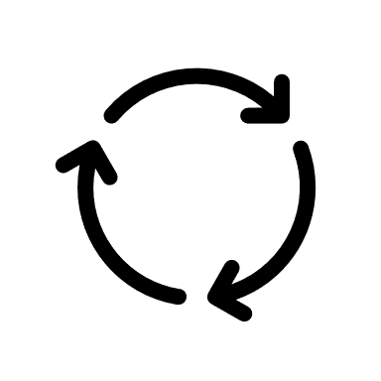
Hestia
An efficient cross-level debugger for HLS designs that enables breakpoints and stepping at multiple granularity
Debug
Interface
cmd
software
level
Multi-level
Interpreter
Breakpoint
Watchpoint
Step
Continue
Switch
Load
……
SCF
check
exec
IR
TOR
sync
HEC
cmd
schedule
level
generate
check
Equivalence
Mapping
sync
verify
cmd
structure
level
check

Slide 46
Debugging at SCF
cd hestia
hestia
exit

Slide 47
Debugging at SCF
cd tutorial/examples/case1
hestia command.tcl
continue
mem op_3
exit
cat data/D_out.txt
load scf.json
load_memory_file op_0 data/A.txt
load_memory_file op_1 data/B.txt
load_memory_file op_2 data/C.txt
call main
RETURN:
op_3 Memory {
store: [
I32(30773412), I32(43773702), I32(39399768), I32(42375816),
I32(39878346), I32(46819968), I32(38864916), I32(42650712),
I32(41010798), I32(41823036), I32(32292810), I32(33290802),
I32(41601426), I32(40812594), I32(42230898), I32(43038654),
I32(32263200), I32(44749656), I32(40505076), …
]
}
Differs from output result.

Slide 48
Debugging interface
hestia command.tcl
breakpoint op_116
continue
var op_115
unset_breakpoint op_116
show_breakpoint
watch op_135_b
watch op_131_b
watch op_115
step 10000
show_op
step 2
SHOW VALUE:
op_115 I32(0)
SHOW VALUE:
op_115 I32(6)
op_135_b I32(1)
op_131_b I32(3)
op_115 I32(6)
op_135_b I32(1)
op_131_b I32(3)
op_115 I32(6) …
Computation { operands: ["op_135_b", "op_113"], op_type: "shift_left", name: "op_114", ret_type: "i32" }
SHOW VALUE:
op_115 I32(6)
op_135_b I32(1)
op_131_b I32(3)
op_115 I32(7)
op_135_b I32(1)
op_131_b I32(3)

Slide 49
Multi-level Interpreter
Schedule simulation is organized as an instance pool
valuable insights into the timing behavior of the design
Function list
Instance pooling
Top (stall)
Top:
Dataflow
s1, s2, s3
…
Son:
Pipeline II=3
Time Graph
Operation
…
s1
s3
s2

Slide 50
Multi-level Interpreter
Schedule simulation is organized as an instance pool
valuable insights into the timing behavior of the design
Function list
Instance pooling
Pipeline
Top (stall)
Env
Top:
Dataflow
s1, s2, s3
…
Env
Env
Env
op_56:
I32(336)
op_67:
F32(2.11234)
…
Son:
Pipeline II=3
Time Graph
Operation
…
s1
s3
Stage list
[1, 4, 7]
s2

Slide 51
Multi-level Interpreter
Structural interpreter constructs a hierarchical structure
Controller, primitives, sub-modules
Top
State Transition Graph
Controller
S0
Assignments
assign %f1.in=%a
assign %Add.in=%b
…
Primitives
Modules
S1
S2
…
S3
StageSet
S2
StageSet
S1
Controller
Primitives
Instances
Primitives
Instances
Primitives
Modules

Slide 52
Multi-level Interpreter
Structural interpreter constructs a hierarchical structure
Controller, primitives, sub-modules
Top
State Transition Graph
Controller
S0
Assignments
assign %f1.in=%a
assign %Add.in=%b
…
Primitives
Modules
S1
S2
…
…
Multiplier
Register
S3
Mul_7
operand0 = I32(23)
operand1 = I32(31)
result = I32(713)
Adder
StageSet
S2
Reg_2
operand0 = I32(27)
StageSet
Ports
Inner
state
S1
Add_1
operand0 = I32(23)
operand1 = I32(131)
result = I32(154)
Controller
Primitives
Instances
Primitives
Instances
Propagate & update
Primitives
Modules

Slide 53
Simulation Speedup
cd ../../benchmarks/collection1
time hestia command/aeloss_push/tor.tcl
time hestia command/aeloss_push/hec.tcl
 | TOR IR | HEC IR
Cycle | 1502609 | 1502706
Time | 2.019s | 37.711s

Slide 54
Debugging at TOR & HEC levels
cd ../../examples/case2
hestia tor.tcl
cat data/C_out.txt
load tor.json
load_memory_file op_0 data/C.txt
load_memory_file op_1 data/A.txt
load_memory_file op_2 data/B.txt
call main
continue
mem op_0
exit
Same as the output result.
Cycle count: 26283
op_0 Memory{
store: [
I32(738698), I32(34), I32(90), I32(26), I32(24), I32(57),
I32(14), I32(68), I32(5), I32(58), I32(12), I32(86), I32(0),
I32(46), I32(26), I32(94), I32(1099936), I32(1070152),
I32(78), I32(29), I32(46), I32(90), I32(47), I32(70), I32(51),
I32(80), I32(31), I32(93), I32(57), I32(27), I32(12), …
]
}

Slide 55
Debugging at TOR & HEC levels
hestia hec_wrong.tcl
load hec_wrong.json
load_memory_file mem_global_0 data/C.txt
load_memory_file mem_global_1 data/A.txt
load_memory_file mem_global_2 data/B.txt
call main
continue
mem mem_global_0
exit
thread 'main' panicked at src/lib/basetype.rs:168:35:
index out of bounds: the len is 256 but the index is 256

Slide 56
Debugging at TOR & HEC levels
hestia cosim.tcl
load tor.json
load_memory_file op_0 data/C.txt
load_memory_file op_1 data/A.txt
load_memory_file op_2 data/B.txt
call main
load hec_wrong.json
#load hec.json
load_memory_file mem_global_0 data/C.txt
load_memory_file mem_global_1 data/A.txt
load_memory_file mem_global_2 data/B.txt
call main
load_equal equal.json
cosim
exit
thread 'main' panicked at src/lib/equal.rs:77:17:
assertion `left == right` failed:
Value Mismatch:
operation "op_44" and primitive "muli_main_0”
at state @s14
left: I32(624)
right: I32(432)

Slide 57
Debugging at TOR & HEC levels
hestia cosim.tcl
diff hec_wrong.json hec.json
load tor.json
load_memory_file op_0 data/C.txt
load_memory_file op_1 data/A.txt
load_memory_file op_2 data/B.txt
call main
#load hec_wrong.json
load hec.json
load_memory_file mem_global_0 data/C.txt
load_memory_file mem_global_1 data/A.txt
load_memory_file mem_global_2 data/B.txt
call main
load_equal equal.json
cosim
exit
Cosimulation Pass

Slide 58
Summary
Multi-level IR infrastructure
Shows remarkable flexibility to domain-specific applications
Systolic array generation
Achieves optimization in specific tasks through sophisticated dataflow and loop transformations, enhancing performance.
High-level synthesis and debugger
Essential for reliable hardware design and verification

Slide 59
RTL Simulator with Cross-Cycle Optimization
Speaker: Kexing Zhou
周可行

Slide 60
Khronos: RTL Simulator with Cross-Cycle Optimization
Cement
(cmt2)
Test
bench
Khronos
(ksim)
EXE File
(sim.exe)
Hector
Chisel
Origen
Verilog
Cross-cycle optimization
(yosys)
Frontend Languages
Khronos Inputs
Covered in CMT/Origen
Covered in This Section

Slide 61
Outline
Compilation workflow of Khronos
Input Preparation
Header and Code Generation
Testbench Preparation
Compile and Linking
Intermediate Representation of Khronos
Flattening, Fusing, Lowering, Queuing
Real Application Evaluation

Slide 62
Outline
Compilation workflow of Khronos
Input Preparation
Header and Code Generation
Testbench Preparation
Compile and Linking
Intermediate Representation of Khronos
Flattening, Fusing, Lowering, Queuing
Real Application Evaluation

Slide 63
Compilation Flow of Khronos
Khronos is based on MLIR & CIRCT
firtool: Translate input to CIRCT IR
ksim:
Translate hw logic to llvmir
Generate header file for testbench
llc: compile llvmir to linkable object
clang++: compile and link testbench
firtool
CIRCT
(.mlir)
(1) .fir -> .mlir
(2) run ksim
cpp
(.h)
Khronos
(ksim)
LLVM
(.ll)
(3) .ll -> .o
Command Cheet Sheet
Test
bench
Compile & Link
(1) firtool-ksim --ir-hw $1.fir -o $1.mlir
(2) ksim $1.mlir -v -o $1.ll --out-header=$1.h
(3) llc-ksim -O2 -filetype=obj $1.ll -o $1.o
(4) clang++ -O2 $1.o $1.cpp -o $1
(4) .cpp, .o -> .exe
sim
(.exe)

Slide 64
Khronos Flow: Prepare Input
circuit SimpleFIR:
module SimpleFIR:
input clock: Clock
input reset: UInt<1>
input in: SInt<16>
output sum: SInt<16>
reg r1: SInt<16>, clock
reg r2: SInt<16>, clock
reg r3: SInt<16>, clock
r1 <= in
r2 <= r1
r3 <= r2
sum <= add(add(in, r1), add(r2, r3))
simplefir.fir
Please enter `ksim/example` and open `simplefir.fir`.
This is a FIRRTL file.
Top modules names the same as circuit
Basic type, `UInt` and `SInt`
Use `<=` to connect signals
module {
......
hw.module @SimpleFIR( %clock: i1,
%reset: i1, %in: i16) -> (sum: i16) {
%r1 = seq.firreg %in clock %clock {...} : i16
%r2 = seq.firreg %r1 clock %clock {...} : i16
%r3 = seq.firreg %r2 clock %clock {...} : i16
%0 = comb.add %in, %r1, %r2, %r3 : i16
hw.output %0 : i16
}
}
simplefir.mlir
Translate it to CIRCT IR
firtool-ksim simplefir.fir -ir-hw \
-o simplefir.mlir
module => `hw.module`
registers => `seq.firreg`
comb logics => `comb.xxx`

Slide 65
Khronos Flow: Generate Header and IR
module {
......
hw.module @SimpleFIR( %clock: i1,
%reset: i1, %in: i16) -> (sum: i16) {
%r1 = seq.firreg %in clock %clock {...} : i16
%r2 = seq.firreg %r1 clock %clock {...} : i16
%r3 = seq.firreg %r2 clock %clock {...} : i16
%0 = comb.add %in, %r1, %r2, %r3 : i16
hw.output %0 : i16
}
}
simplefir.mlir
Compile the file using Khronos
ksim simplefir.mlir \
--out-header=simplefir.h \
-o simplefir.ll
.ll file contains the logic of simulator
.h file contains IO signals
`clock` is removed in IO signals
call the eval function to advance 1 cycle
...
define void @SimpleFIR() {
%1 = load i16, ptr @in, align 2
%2 = load i16, ptr @in_0, align 2
store i16 %1, ptr @in_0, align 2
%3 = load i16, ptr @queue, align 2
store i16 %2, ptr @queue, align 2
%4 = load i16, ptr @queue_0, align 2
store i16 %3, ptr @queue_0, align 2
%5 = add i16 %1, %2
%6 = add i16 %5, %3
%7 = add i16 %6, %4
store i16 %7, ptr @sum, align 2
ret void
}
simplefir.ll
#pragma once
...
__attribute__((weak)) /* input */ uint8_t reset; // i1
__attribute__((weak)) /* input */ uint16_t in; // i16
__attribute__((weak)) /* output */ uint16_t sum; // i16
void SimpleFIR();
#define eval SimpleFIR
#define SimpleFIR_output_ahead 0
#define SimpleFIR_reset_ahead 0
simplefir.h

Slide 66
Khronos Flow: Prepare Testbench
Khronos can generate a skeleton testbench
Add custom peek/poke statements in the testbench
ksim simplefir.mlir \
--out-driver=simplefir.cpp \
-o simplefir.ll
Set in port `in` to the cycle number
Print the IO signal of the circuit
int main(int argc, char ** argv) {
int cnt = atoi(argv[1]);
reset = 1;
for(auto i = SimpleFIR_reset_ahead; i >= 0; i--) {
SimpleFIR();
reset = 0;
}
auto start = system_clock::now();
for(auto i = 0; i < cnt; i++) {
in = i;
SimpleFIR();
printf(“cycle=%d in=%d sum=%d\n”, i, in, sum);
}
auto stop = system_clock::now();
// ...
return 0;
}
simplefir.cpp
int main(int argc, char ** argv) {
int cnt = atoi(argv[1]);
reset = 1;
for(auto i = SimpleFIR_reset_ahead; i >= 0; i--) {
SimpleFIR();
reset = 0;
}
auto start = system_clock::now();
for(auto i = 0; i < cnt; i++) {
SimpleFIR();
}
auto stop = system_clock::now();
// ...
return 0;
}
simplefir.cpp

Slide 67
Khronos Flow: Compile, Link and Run
Use llc (llvmir compiler) to compile the generated code
❯ ./simplefir 10
cycle=0 in=0 sum=0
cycle=1 in=1 sum=1
cycle=2 in=2 sum=3
cycle=3 in=3 sum=6
cycle=4 in=4 sum=10
cycle=5 in=5 sum=14
cycle=6 in=6 sum=18
cycle=7 in=7 sum=22
cycle=8 in=8 sum=26
cycle=9 in=9 sum=30
112
llc-ksim --filetype=obj \
simplefir.ll -o simplefir.o
Use clang++ to compile testbench and link exe file
clang++ simplefir.cpp simplefir.o -o simplefir
Run the simulator
./simplefir 10
(This is elapsed time)

Slide 68
Outline
Compilation workflow of Khronos
Input Preparation
Header and Code Generation
Testbench Preparation
Compile and Linking
Intermediate Representations in Khronos
Flattening, Fusing, Lowering, Queuing
Real Application Evaluation

Slide 69
Intermediate Representation of Khronos
Khronos has many internal IR
flattened: flatten modules to build graph
fused: fuse registers
low: register => queue
ksim --help
--out=<value> - Output file type
=core - Default circt core IR
=flattened - Ksim high level ir
=fused - Ksim fused ir
=low - KSim low level ir
=llvm - LLVM dialect
=llvmir - LLVM IR
(1) flatten
(2) fuse
(3) lower

Slide 70
Phase 1: Flatten
circuit Tree:
module Tree:
input clock: Clock
input reset: UInt<1>
input in: SInt<16>[4]
output sum: SInt<16>
reg r0: SInt<16>, clock
reg r1: SInt<16>, clock
reg r2: SInt<16>, clock
r0 <= add(in[0], in[1])
r1 <= add(in[2], in[3])
r2 <= add(r0, r1)
sum <= r2
tree.fir
Please enter `ksim/example` and open `tree.fir`
Translate it to mlir
firtool-ksim tree.fir -ir-hw -o tree.mlir
Show ksim IR:
ksim tree.mlir -out=flattened -o tree.flattened.mlir
module {
hw.module @Tree(%clock: i1, %reset: i1,
%in_0: i16, %in_1: i16,
%in_2: i16, %in_3: i16) -> (sum: i16) {
%r0 = seq.firreg %0 clock %clock {...} : i16
%r1 = seq.firreg %1 clock %clock {...} : i16
%r2 = seq.firreg %2 clock %clock {...} : i16
%0 = comb.add %in_0, %in_1 : i16
%1 = comb.add %in_2, %in_3 : i16
%2 = comb.add %r0, %r1 : i16
hw.output %r2 : i16
}
}
tree.flattened.mlir
Only one module,
flattened IR is identical to mlir

Slide 71
Phase 2: Fusing
Run state fusion algorithm in Khronos
After state fusion
“ksim.delay” attribute is attached to each register
if delay = 0, it is fused, and will be remove later
“output_ahead” captures how many cycles output advanced
ksim tree.flattened.mlir \
-in=flattened -out=fused \
-o tree.fused.mlir
module {
hw.module @Tree(%clock: i1, %reset: i1,
%in_0: i16, %in_1: i16,
%in_2: i16, %in_3: i16) -> (sum: i16) {
%r0 = seq.firreg %0 clock %clock {...} : i16
%r1 = seq.firreg %1 clock %clock {...} : i16
%r2 = seq.firreg %2 clock %clock {...} : i16
%0 = comb.add %in_0, %in_1 : i16
%1 = comb.add %in_2, %in_3 : i16
%2 = comb.add %r0, %r1 : i16
hw.output %r2 : i16
}
}
tree.flattened.mlir
module {
hw.module @Tree(%clock: i1, %reset: i1,
%in_0: i16, %in_1: i16,
%in_2: i16, %in_3: i16) -> (sum: i16) attributes {
ksim.output_ahead = 2 : i64
} {
%r0 = seq.firreg %0 clock %clock {ksim.delay=0:i64} : i16
%r1 = seq.firreg %1 clock %clock {ksim.delay=0:i64} : i16
%r2 = seq.firreg %2 clock %clock {ksim.delay=0:i64} : i16
%0 = comb.add %in_0, %in_1 : i16
%1 = comb.add %in_2, %in_3 : i16
%2 = comb.add %r0, %r1 : i16
hw.output %r2 : i16
}
}
ksim.fused.mlir

Slide 72
Phase 3: Lowering
module {
ksim.low.def_queue @clock depth 1 : i1 delay [0]
ksim.low.def_queue @reset depth 1 : i1 delay [0]
ksim.low.def_queue @in_0 depth 1 : i16 delay [0]
ksim.low.def_queue @in_1 depth 1 : i16 delay [0]
ksim.low.def_queue @in_2 depth 1 : i16 delay [0]
ksim.low.def_queue @in_3 depth 1 : i16 delay [0]
ksim.low.def_queue @sum depth 1 : i16 delay [0]
func.func @Tree() attributes {ksim.output_ahead = 2 : i64} {
%0 = ksim.low.get_queue @in_0[0] : i16
%1 = ksim.low.get_queue @in_1[0] : i16
%2 = ksim.low.get_queue @in_2[0] : i16
%3 = ksim.low.get_queue @in_3[0] : i16
%4 = comb.add %0, %1, %2, %3 : i16
ksim.low.push_queue @sum %4 : i16
return
}
}
tree.low.mlir
Lower the fused IR to low level queue IR
ksim tree.fused.mlir \
-in=fused -out=low \
-o tree.low.mlir
IO, registers are converted to queue
Register R/W ops are converted to `get_queue`, `push_queue` ops

Slide 73
Outline
Compilation workflow of Khronos
Input Preparation
Header and Code Generation
Testbench Preparation
Compile and Linking
Intermediate Representation of Khronos
Flattening, Fusing, Lowering, Queuing
Real Application Evaluation

Slide 74
Real Application Evaluation
We run khronos on real world design, Gemmini
A full run is time consuming, we only run khronos on its core PE array
Please enter `ksim/example`
Compile it using khronos
Compile it using verilator
firtool-ksim Mesh6x6.fir --ir-hw -o Mesh6x6.mlir
ksim Mesh6x6.mlir \
--out-header=Mesh6x6.h \
--out-driver=Mesh6x6.cpp \
-o Mesh6x6.ll
llc-ksim -O2 \
--relocation-model=dynamic-no-pic \
--filetype=obj \
Mesh6x6.ll -o Mesh6x6.ksim.o
clang++ -O2 Mesh6x6.cpp Mesh6x6.ksim.o -o Mesh6x6
firtool-ksim Mesh6x6.fir -o Mesh6x6.v
verilator --cc --exe --build \
Mesh6x6.v Mesh6x6.tb.cpp
The compilation is a little slow

Slide 75
Real Application Evaluation
The testbench will print elapsed time, run each tb and compare the result
Result varies on your platform
Khronos
Verilator
❯ ./Mesh6x6 100000
200646
❯ ./obj_dir/VMesh6x6 100000
1759708
8.77x faster

Slide 76
HDL and Framework for Chip Design
Speaker: Youwei Xiao, Zizhang Luo
肖有为 罗梓璋

Slide 77
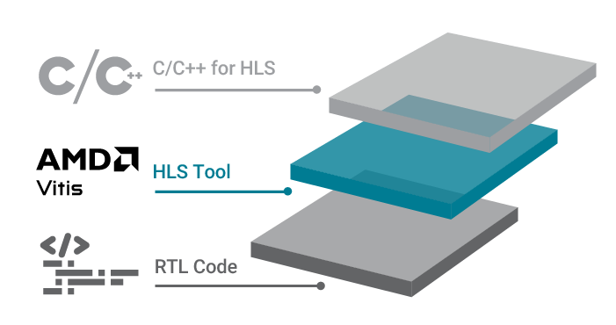
Cement: Better HDL and Framework for Chip Design
Traditional HDL
tedious hardware code
Embedded HDL (eHDL)
design hardware in advanced programming language (Scala, Python)
?
HLS: design hardware in C/C++
Cement (cmt2!)
Rust-embedded HDL
software-like control description
keep evolving…
Cement (cmt1)
published at FPGA’24
rule-based design
Youwei Xiao, Zizhang Luo, Kexing Zhou, and Yun Liang. 2024. Cement: Streamlining FPGA Hardware Design with Cycle-Deterministic eHDL and Synthesis. FPGA '24. https://doi.org/10.1145/3626202.3637561
High-level HDL: describe hardware as rules

Slide 78
Today, we introduce cmt2!
as the successor of …
Cement (cmt1)
published at FPGA’24
Rust-embedded HDL
cmt2!
rule-based design
software-like control description

Slide 79
We choose Rust, because…
Rust has been the top admired programming language for 7 consecutive years
In our own experience, it’s powerful, efficient, user-friendly
Rust is admired by 82.2%!

Slide 80
In Rust, cmt2 project looks like…
cd $REPOS/cmt2 && ls –a
include necessary build flags
cmtrs eHDL
Here, 5 library crates forms the cmt2 package
cmtir IR
kir
cmtc
compiler
backends
specify rust version
specify package information and dependencies

Slide 81
Hello Rust World!
touch $REPOS/cmt2/crates/cmtc/examples/hello.rs
create hello.rs file ↑
click [run] above fn main, or …
under directory $REPOS/cmts
Cargo is Rust’s build system and package manager. It’s easy-to-use!
More user-friendly than sbt for Scala/Chisel!
cargo run --example hello

Slide 82
Hello cmt2!
at the top of hello.rs
use clauses import cmt2’s eHDL and compiler features
itfc_declare! is a macro
macro in Rust transforms code at the token-level
If curious, feel free to run (if have internet connection):
cargo install cargo-expand
cd $REPOS/cmt2/crates/cmtc
cargo expand --example hello
to see the transformed code!

Slide 83
Hello cmt2!
at the top of hello.rs
macro is an advanced feature in Rust!
Please leave cmt2 developers to suffer😂
and… just use them!😁
The left code creates …
A module interface named A2B;
It has one input port a, one output port b, both of which have type T.
It exposes a method run for external world to invoke!
A2B
a:T
method run
b:T

Slide 84
cmt2 is rule-based HDL
at the top of hello.rs
A2B
a:T
method run
b:T
cmt2!
rule-based design
Hardware logic is organized as rules – the execution unit!
Don’t be afriad!😁
Just consider one rule as a group of operations that execute together
In cmt2, we have two types of rules: method rules and always rules:
method rule need to be invoked (Bluespec method)
always rule runs actively (Bluespec rule)

Slide 85
cmt2 is rule-based HDL
following itfc_declare!
fn starts a function!
The #[module] macro transfoms the function add1 to create a module of the interface A2B
UInt(4)
add1 of
A2B
a:T
method run
b:T
b=a+1
Now, types are given, rules are filled -- Module is completely described!

Slide 86
cmt2 generates SystemVerilog
following fn add1
The new main function to call elaborate for the add1 module
click [run] above fn main, or …
cargo run --example hello
cat add1.sv

Slide 87
Show features by examples
as the successor of …
Cement (cmt1)
published at FPGA’24
FIR
GEMM
Rust-embedded HDL
cmt2!
rule-based design
software-like control description

Slide 88
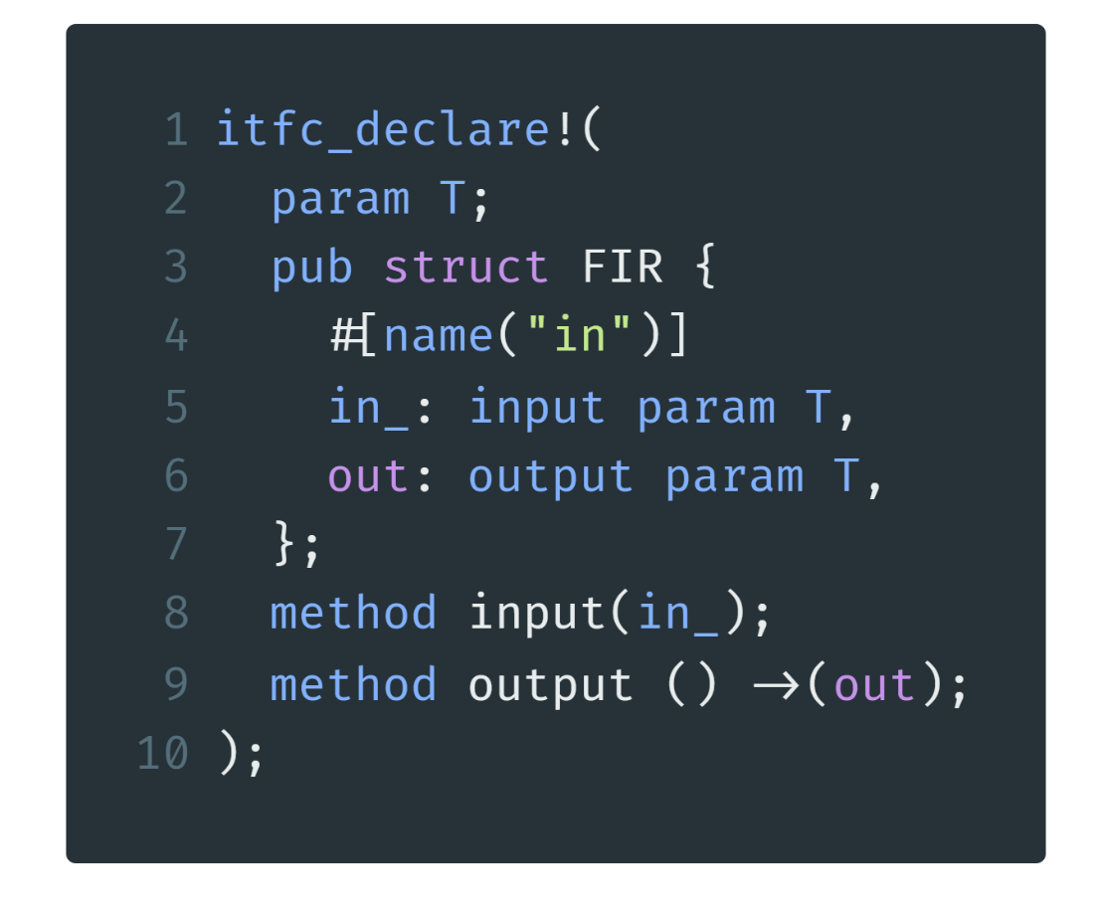
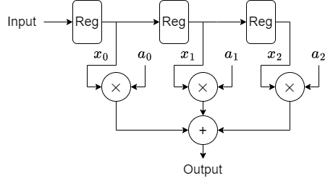
Finite Impulse Response
cmt2!
Rust-embedded HDL
Name of Interface/Module
Type Parameter
An input port
named “in_”
of type T
rename
A method to input data
A method to output data
./crates/cmtc/examples/fir.rs line 7-16

Slide 89
FIR Example1: fixed length
Parameters: type & coefficients
Return a module with interface type FIR
io! macro provides parameters and gets an io struct
instantiate a
Reg as submodule
implement a method
called “input”
input of the method
things to do after the method is invoked
reg %= xx is a syntax sugar for reg.write(xx)
rule-based design
./crates/cmtc/examples/fir.rs line 18-46

Slide 90
FIR Example1: fixed length
implement an always rule called “shift”
shift the registers
implement the output method
return an expression
calculate FIR
convert software value a2 into hardware literal of type t
./crates/cmtc/examples/fir.rs line 18-46

Slide 91
FIR Example2: arbitrary length
An array of coefficients
Still returns FIR
Instantiate
a vector of
Regs
Input to the first reg
Rust-embedded HDL
./crates/cmtc/examples/fir.rs line 48-78

Slide 92
FIR Example2: arbitrary length
Generate n-1 shifts with a software for expression
Make a multiply accumulate expression with functional programming
./crates/cmtc/examples/fir.rs line 48-78

Slide 93
Explanation on the last expression
For audiences that are not familiar with functional programming
regs
a
map()
zip()
reg0
$$×$$
a0
reg1
$$×$$
a1
$$+$$
reg2
$$×$$
a2
$$+$$
reduce()
reg3
$$×$$
a3
$$+$$
Rust-embedded HDL
iter()
Option<Sum>
unwrap()
Sum

Slide 94
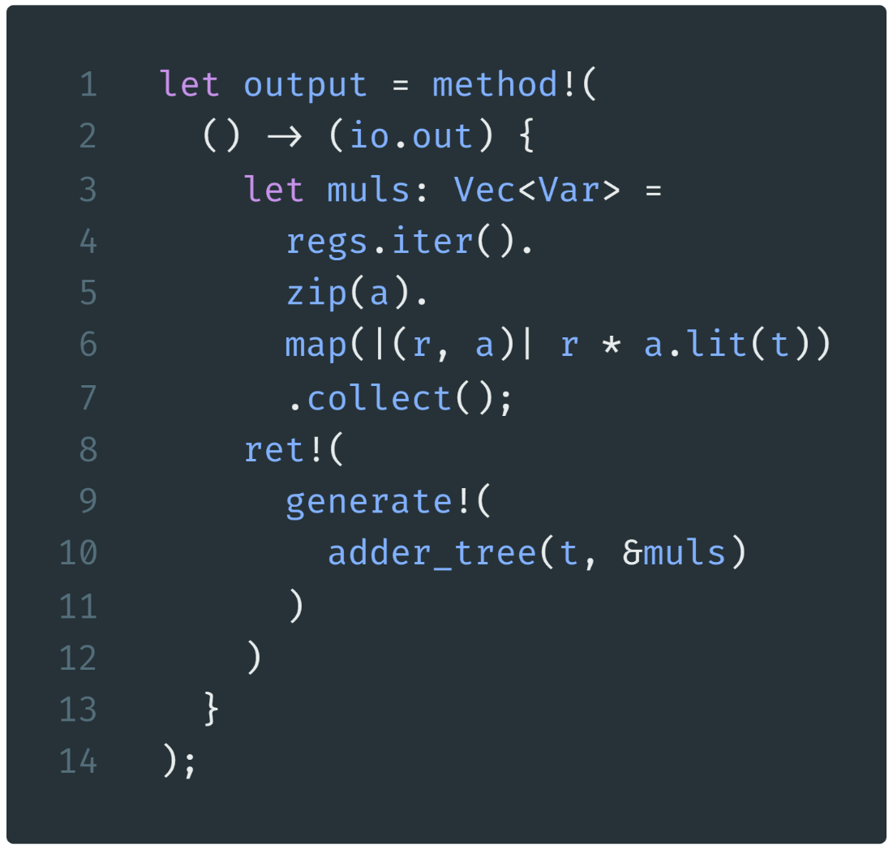
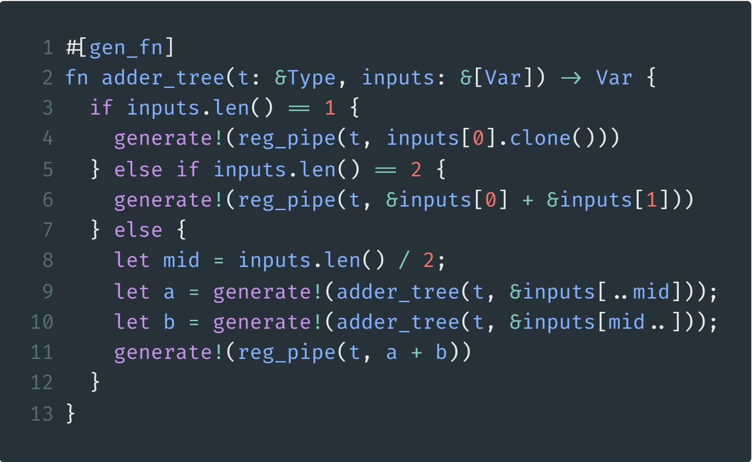
FIR Example3: adder tree
collect multiply results
a gen_fn generates hardware
Variables that will be added
The returned sum
generate one pipeline reg
generate one pipeline reg
for the sum
generate an adder tree
recursive to calculate the left part and the right part
generate one pipeline reg
for the sum
./crates/cmtc/examples/fir.rs line 83-123

Slide 95
FIR Example: Testbench preparation
the interface for the testbench
pass the DUT into the TB
tell the compiler this is a TB
instantiate DUT
a cycle counter for simulation
a rust random generator
./crates/cmtc/examples/fir.rs line 132-174

Slide 96
FIR Example: Testbench inputs
make 10 inputs
make 10 always rules with different name
rule guard
generate an input,
call method
print the input
./crates/cmtc/examples/fir.rs line 132-174

Slide 97
FIR Example: Testbench inputs
rule guard
print during simulation
call method
finish simulation at cycle 20
increase cycle counter
./crates/cmtc/examples/fir.rs line 132-174

Slide 98
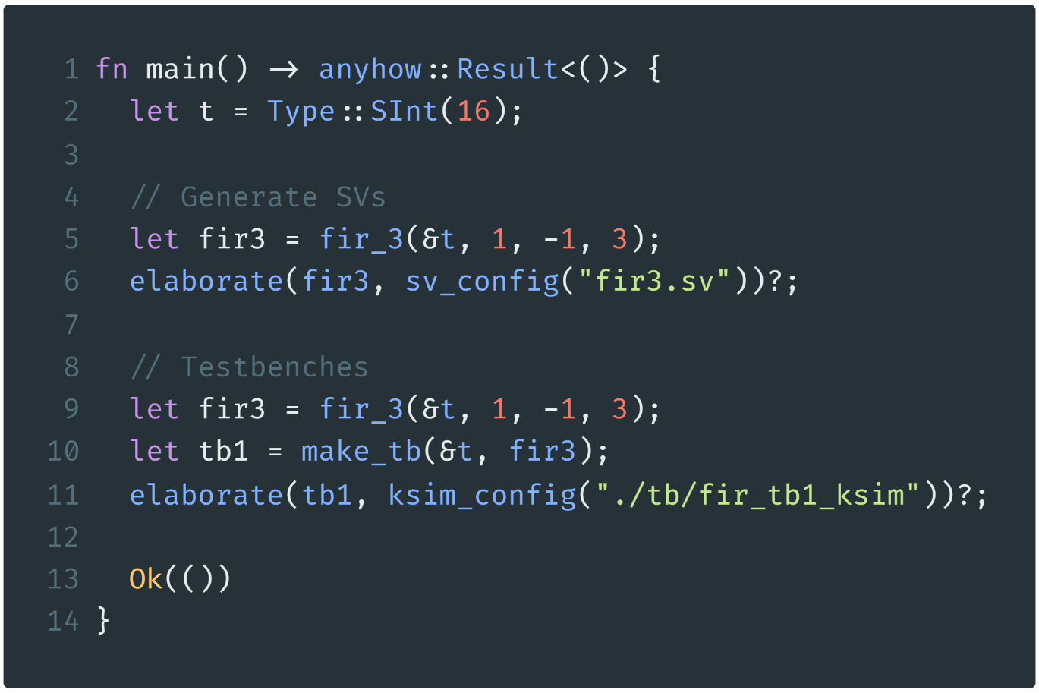
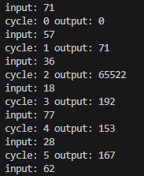
FIR Example: Elaboration & Simulation
main function of Rust
cd $REPOS/cmt2
cargo run –-example fir
cd ./tb/fir_tb1_ksim
make all
./FIR_s6
run Rust
Type: 16-bit signed int
run Khronos
Generate a FIR (first example)
run the simulation program
Elaborate to generate SV
Generate a TB
(FIR is regenerated here)
Elaborate to generate Khronos simulation environment
./crates/cmtc/examples/fir.rs line 176-204
Possible Outputs

Slide 99
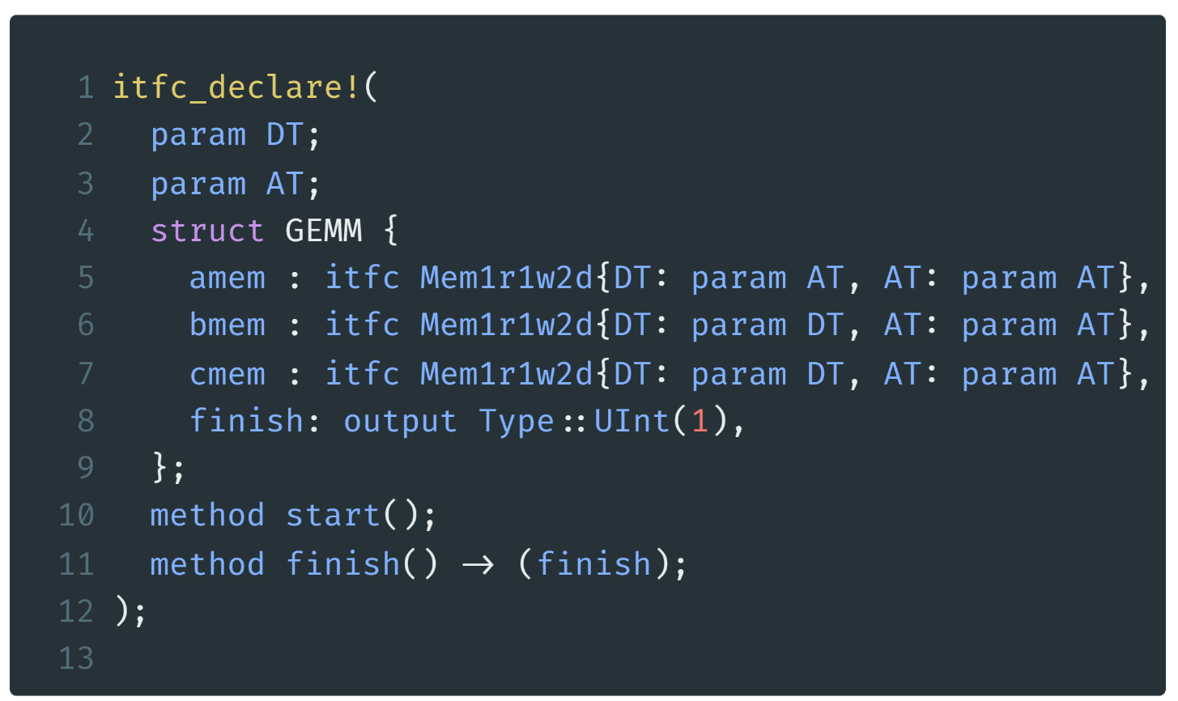
General Matrix Multiplication
cmt2!
write()
software-like control description
A Mem
GEMM
read()
data type
address type
memory as nested interface
B Mem
$$×$$
F
S
M
$$+$$
MAC
simple methods to start computation and report finish
C Mem
./crates/cmtc/examples/gemm.rs line 25-36

Slide 100
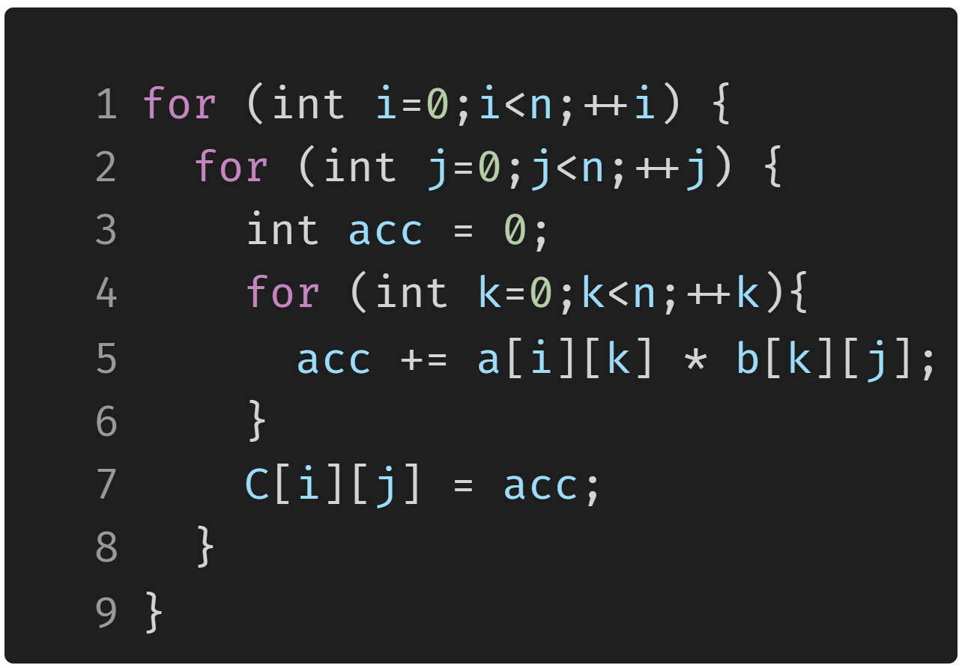
GeMM Example: Software
k
A
k
B
C
j
i
GeMM in C using three for-loops

Slide 101
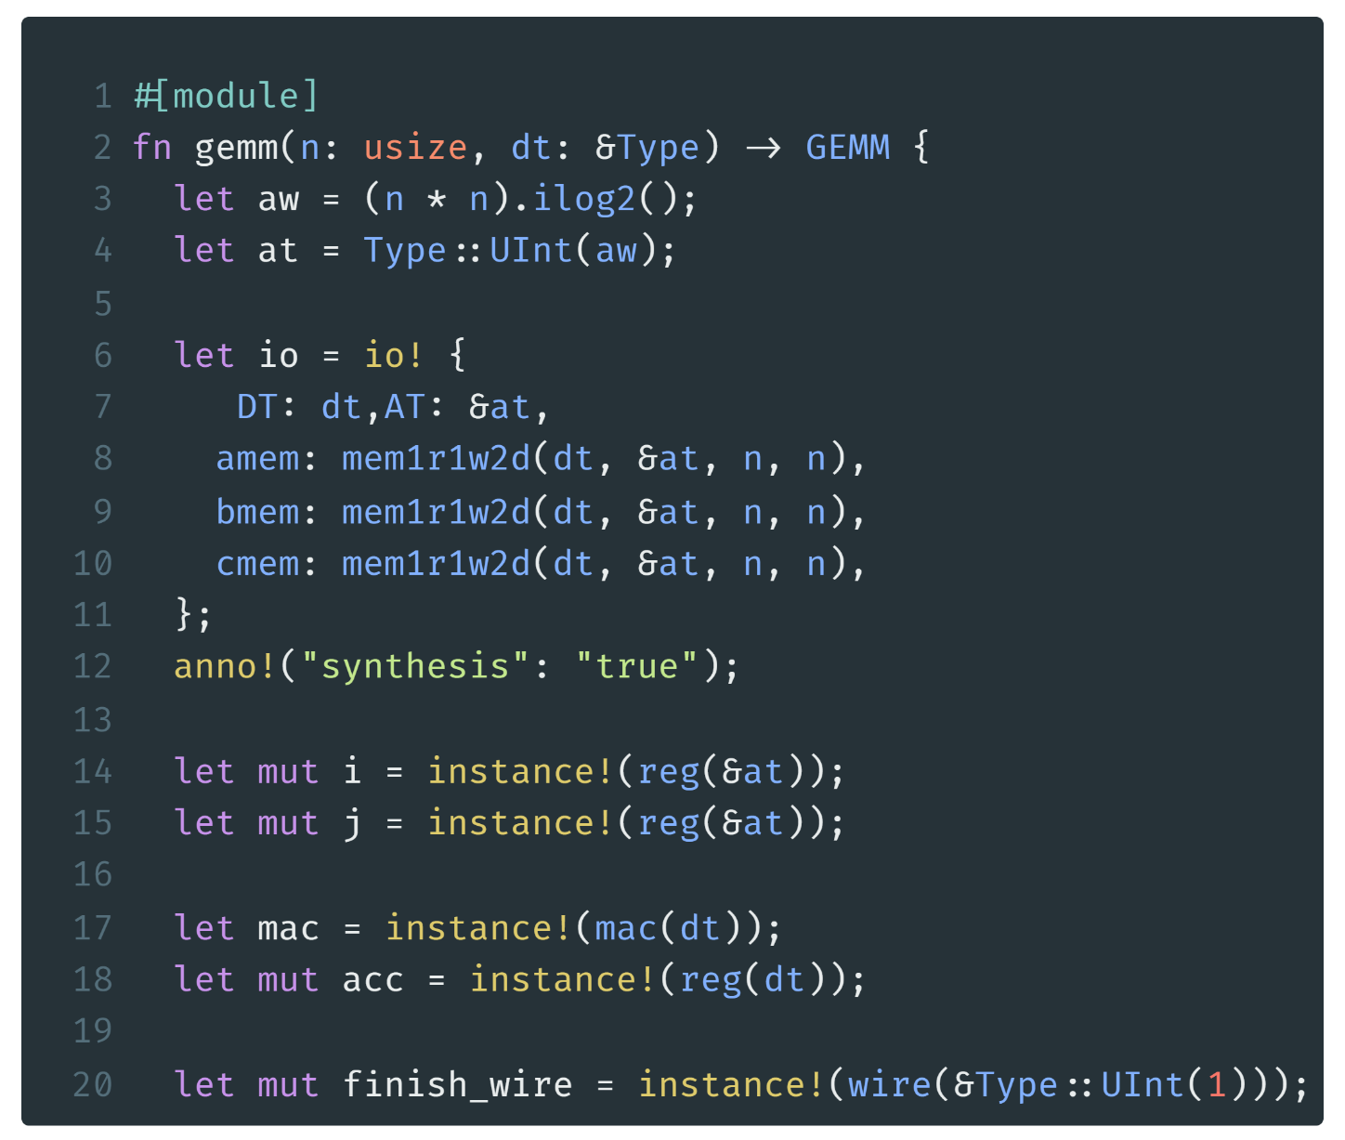
GeMM Example: Preperation
calculate the address type
provide the memory instances to the interface
some register for loops
one MAC unit
one accumulator
./crates/cmtc/examples/gemm.rs line 38-97

Slide 102
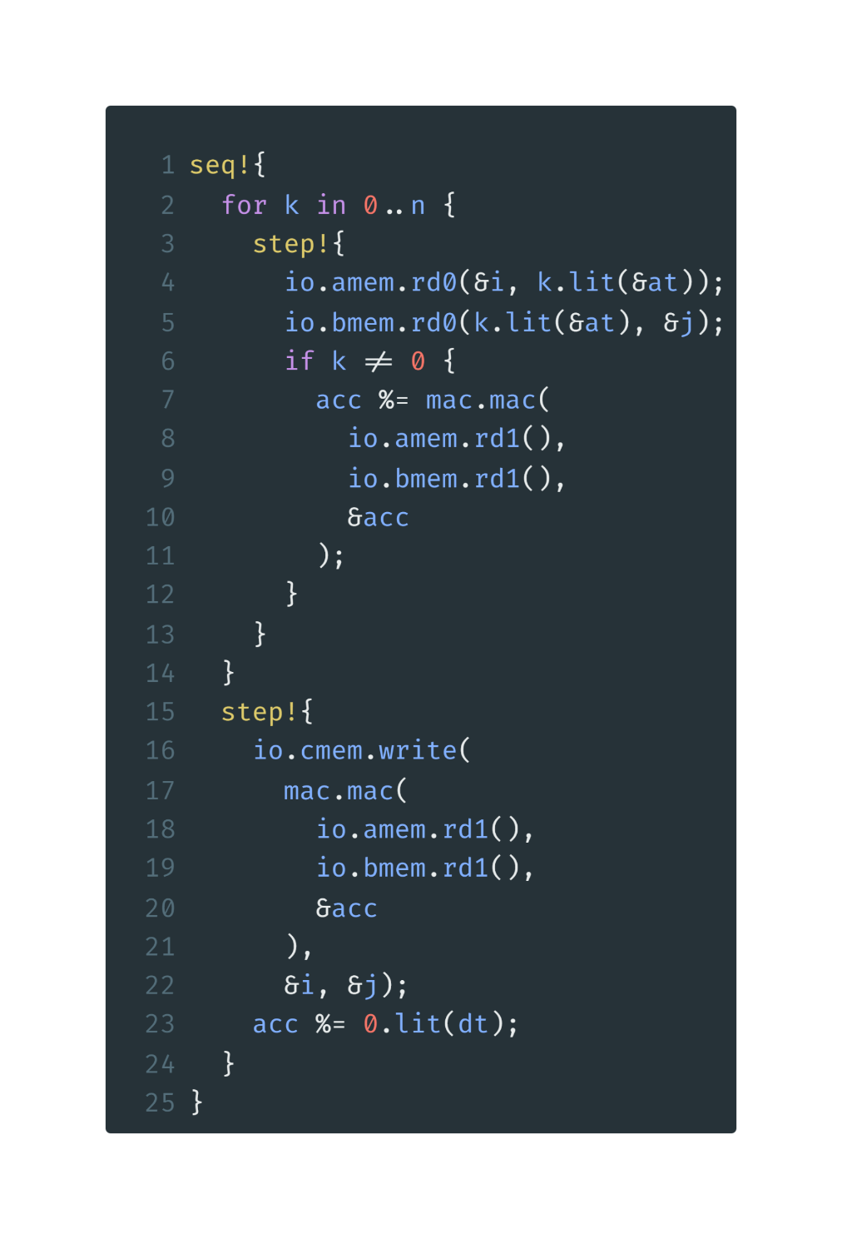
GeMM Example: FSM
software-like control description
keyword
i= 0 to n-1
a for loop
init: i=0
i<n i=0 => 0<n
update: i=i+1
i<n i=i+1 => i<n-1
j= 0 to n-1
./crates/cmtc/examples/gemm.rs line 38-97

Slide 103
GeMM Example: FSM innermost body
for i in 0..n
for j in 0..n
Seq
step0
step1
step2
step3
the following steps will be done in a sequence
amem.rd0
amem.rd0
amem.rd0
amem.rd0
generate n steps
bmem.rd1
bmem.rd1
bmem.rd1
bmem.rd1
The same for all n steps
amem.rd1
amem.rd1
amem.rd1
bmem.rd1
bmem.rd1
bmem.rd1
feed memory address
get memory data
invoke MAC
accumulate result
mac
mac
mac
acc
acc
acc
$$⋮$$
./crates/cmtc/examples/gemm.rs line 38-97

Slide 104
GeMM Example: FSM last step
for i in 0..n
for j in 0..n
Seq
step0
step1
step2
step3
$$⋯$$
step n
$$⋮$$
amem.rd0
amem.rd0
amem.rd0
amem.rd0
write to cmem
bmem.rd1
bmem.rd1
bmem.rd1
bmem.rd1
last mem read and MAC
amem.rd1
amem.rd1
amem.rd1
amem.rd1
bmem.rd1
bmem.rd1
bmem.rd1
bmem.rd1
mac
mac
mac
mac
acc
acc
acc
acc
cmem.write
./crates/cmtc/examples/gemm.rs line 38-97

Slide 105
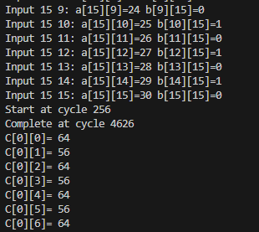
GeMM Example: Simulation
cd $REPOS/cmt2
cargo run –-example gemm
cd ./tb/gemm_ksim
make all
./GEMM_s16_i8
4370
Commands to run simulation
Expected results
Cycles= ($(16+1)$ //k
$×16+1)$ //j
$×16+1$ //i
= 4369
+ 1 cycle to init
+ 1 cycle to init
+ 1 cycle to write finish

Slide 106
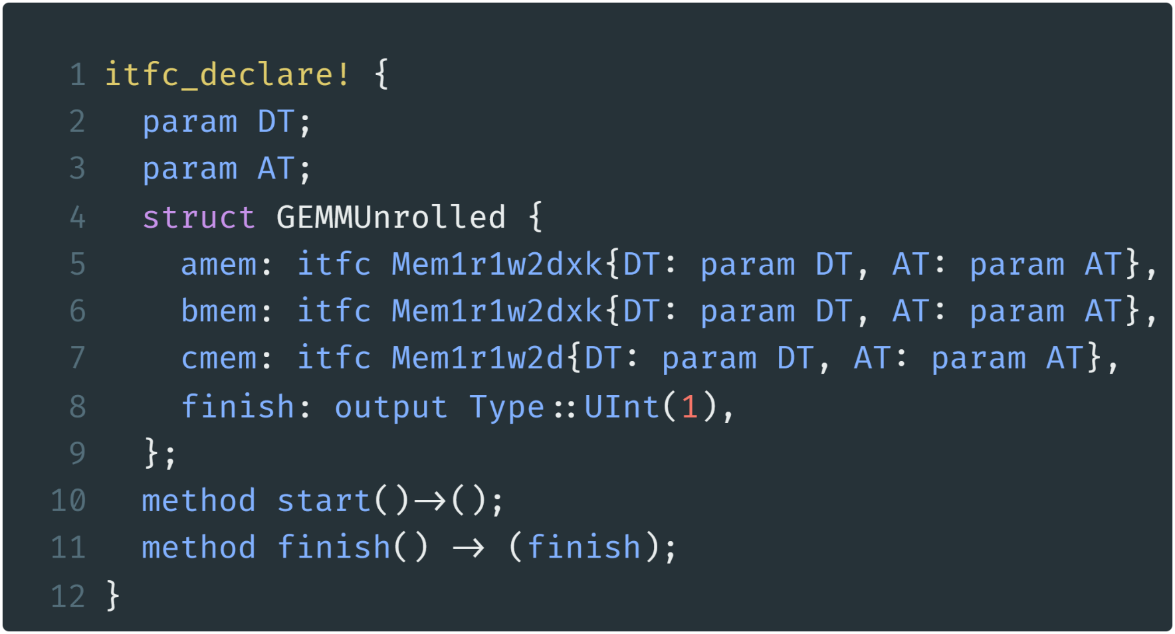
GeMM unrolled Example: Interface Declare
Mem
Mem
Mem
Mem
GEMM
Unrolled
Multi-bank 2D memory
Mem
MAC
MAC
MAC
MAC
Mem
Mem
Mem
$$+$$
FSM
C Mem
./crates/cmtc/examples/gemm_unrolled.rs line 25-36

Slide 107
GeMM unrolled Example: unroll factor
Iter 1
Iter 2
Iter 3
Iter 4
A
unroll factor=4
B
C

Slide 108
GeMM unrolled Example
i
j
k
./crates/cmtc/examples/gemm_unrolled.rs
line 38-114

Slide 109
GeMM unrolled Example: innermost
for i in 0..n
for j in 0..n
Each inner loop have n/factor+1 steps
read factor memory banks at the same time
invoke factor MACs and accumulate
get the sum of all accumulators
write to c memory
./crates/cmtc/examples/gemm_unrolled.rs
line 38-114

Slide 110
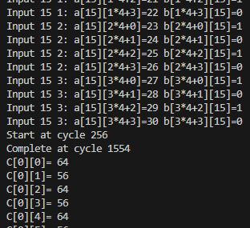
GeMM unrolled Example: Simulation
cd $REPOS/cmt2
cargo run –-example gemm_unrolled
cd ./tb/gemm_unrolled_ksim
make all
./GEMMUnrolled_s16_i8
1298
Commands to run simulation
4370/1298$≈$3.37
Factor=4 results
Cycles= ($(4+1)$ //k
$×16+1)$ //j
$×16+1$ //i
= 1297

Slide 111
use cmt2 as a library
cd $REPOS && cargo new hello
When you’re building a rust project…
cp -r ./cmt2/.cargo ./cmt2/rust-toolchain.toml ./hello
Add rust version and build flag
cd hello
cargo add cmtrs cmtc anyhow
Add cmt2 from crates.io!
This need internet!
cp ../cmt2/crates/cmtc/examples/hello.rs ./src/main.rs && cargo run
Now, feel free to use cmt2 for hardware design

Slide 112
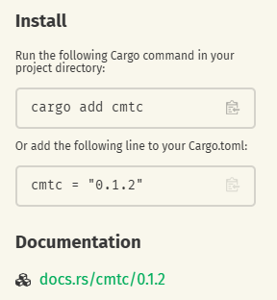
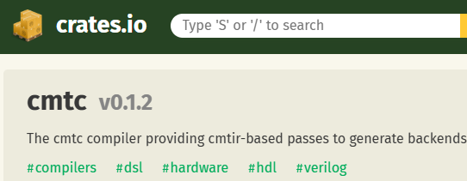
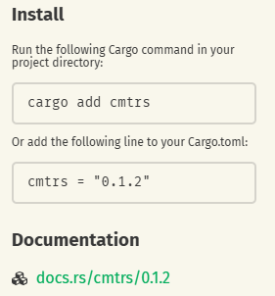
use cmt2 as a library
cd $REPOS && cargo new hello
When you’re building a rust project…
cp -r ./cmt2/.cargo ./cmt2/rust-toolchain.toml ./hello
Add rust version and build flag
cd hello
cargo add cmtrs cmtc anyhow
Add cmt2 from crates.io!
This need internet!
cp ../cmt2/crates/cmtc/examples/hello.rs ./src/main.rs && cargo run
Now, feel free to use cmt2 for hardware design

Slide 113
LLM-Based Chip Design
Speaker: Fan Cui
崔璠

Slide 114
Outline
Introduction
LLM-Driven Hardware Design
Warmup
Adder
GEMM
Testbench
Kernel

Slide 115
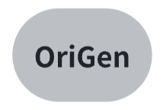
OriGen Model
Using the two datasets obtained in code-to-code augmentation
We train OriGen model based on Qwen-Coder

Slide 116
Complex Hardware Design Flow
For complex hardware, it is hard for LLM to implement the module fully autonomously.
The flow is step-by-step and needs human guidance, especially in the debug process.

Slide 117
Complex Hardware Design Flow
The initial prompt is critical, establishing the module's foundational behavior, adequate guidance from human is helpful.
LLMs can generate both testbench and kernel, but the testbench needs to be validated by human.

Slide 118
Complex Hardware Design Flow
In the design flow, the LLM first generates the testbench based on the specification and then uses it to validate the kernel.
If the testbench or kernel contains bugs, minor syntax errors can be automatically corrected based on compiler feedback.
Complex logic bugs need human guidance

Slide 119
Complex Hardware Design Flow
If we need to design several kernels, the previous design can serve as a reference to speed up the process.

Slide 120
Outline
Introduction
LLM-Driven FPGA Kernel Design
Warmup
Adder
GEMM
Testbench
Kernel

Slide 121
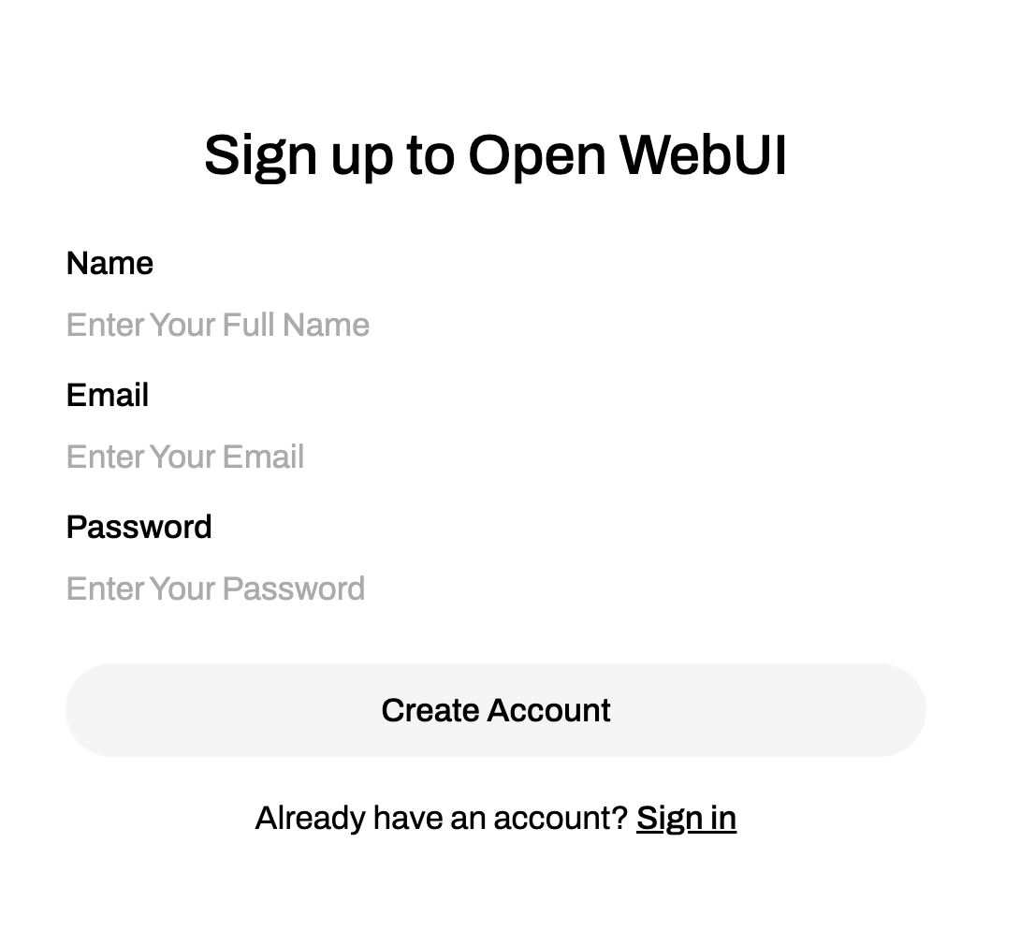
Chat Interface
The chat interface is on origen.ahs.ericlyun.me
Please sign up first
Then you will see the chat interface

Slide 122
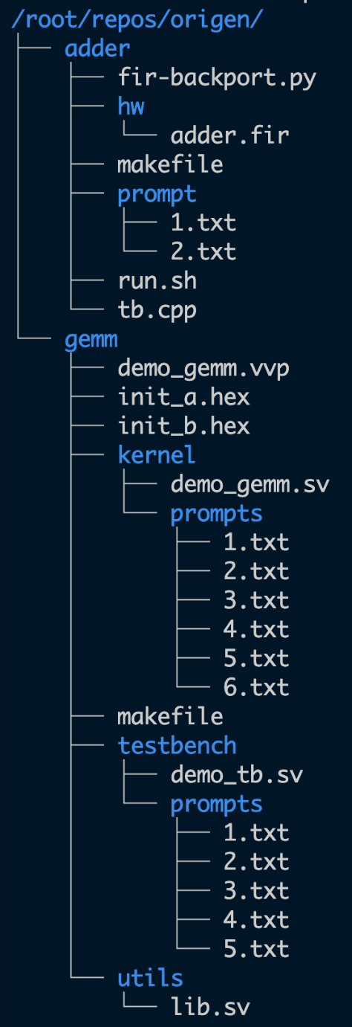
Prompts
To ensure consistent chat behavior, we've saved the prompts in the prompt directory.
You can access it on https://github.com/pku-liang/origen_examples
Each numbered file contains the prompts for the corresponding conversation round.

Slide 123
Warmup
First, we ask LLM to generate a simple 8 bit adder and simulate using ksim.
Copy the prompt of 1.txt

Slide 124
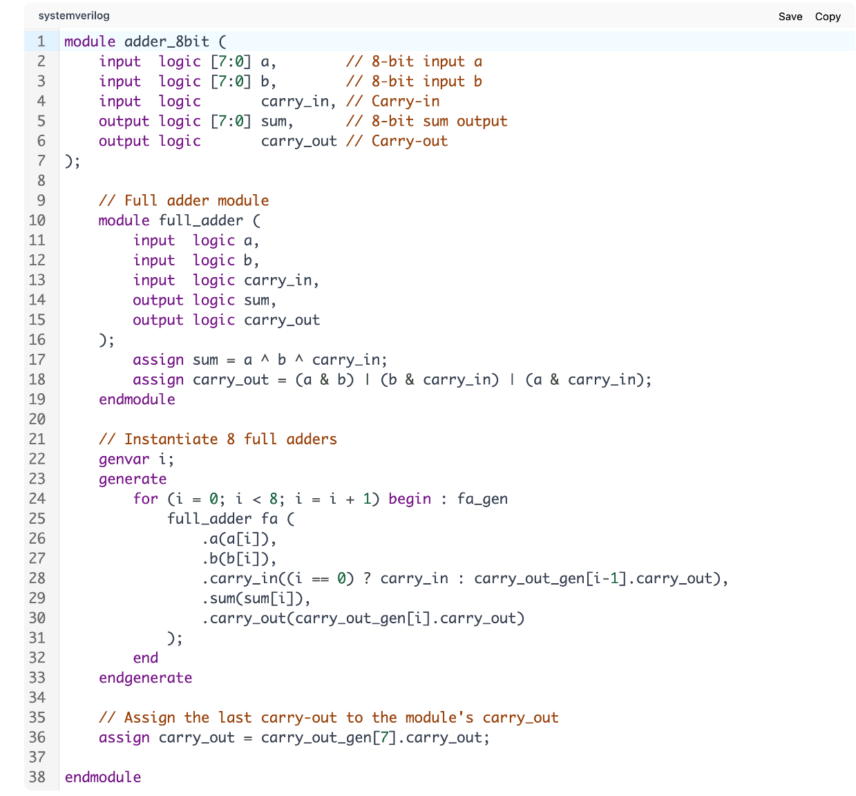
Warmup
The generated code is too complicated!
Copy the prompt of 2.txt to simplify.
Much better now

Slide 125
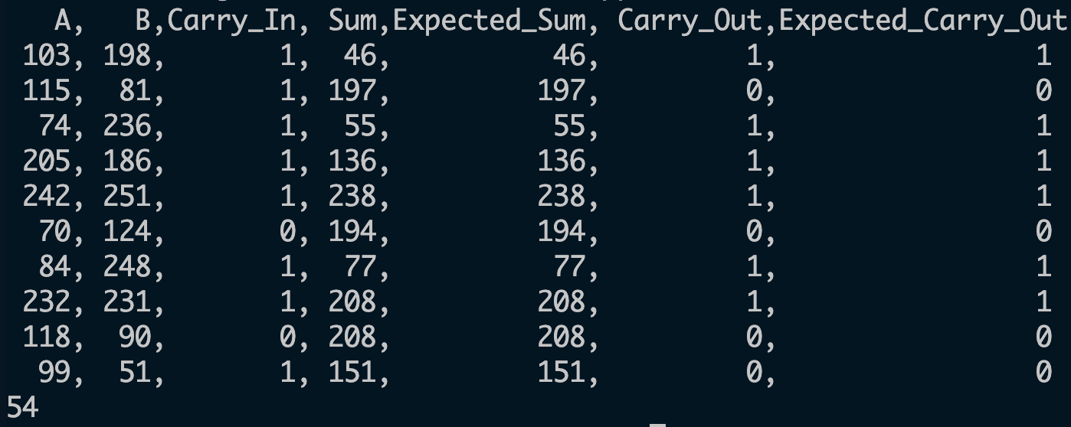
Warmup
Now run run.sh under adder to simulate in ksim
The result is as expected
bash $REPOS/origen/adder/run.sh

Slide 126
Outline
Introduction
LLM-Driven FPGA Kernel Design
Warmup
Adder
GEMM
Testbench
Kernel

Slide 127
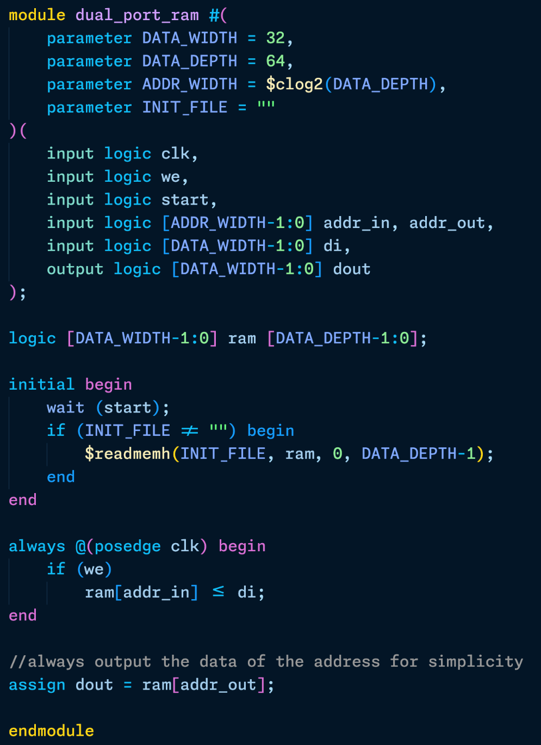
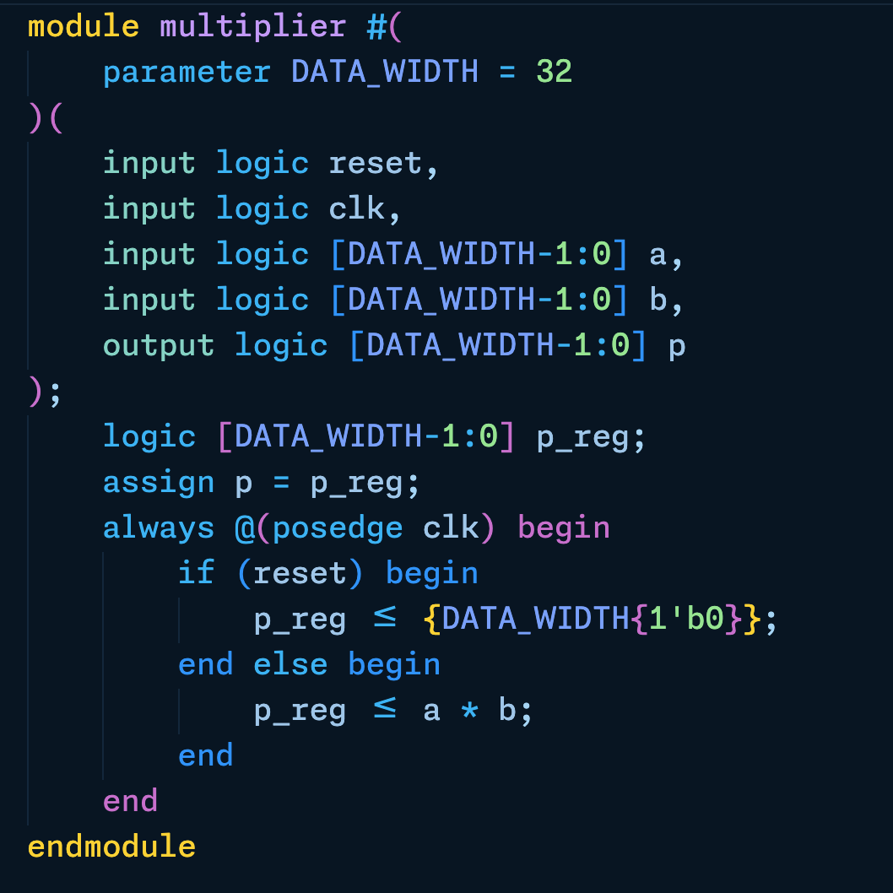
GEMM
In this case, we will use OriGen to generate both the testbench and kernel for GEMM.
We use single-cycle latency multiplier
Dual port ram
Initialized from a hex file
Synchronous write
Asynchronous read
Defined in utils/lib.sv

Slide 128
Code
The testbench and kernel code is approximately 100 lines long, so it may take LLM some time to generate.
We have saved the generated code of each round under code directory
You can access it on https://github.com/pku-liang/origen_examples
We will generate the testbench first, followed by the kernel.

Slide 129
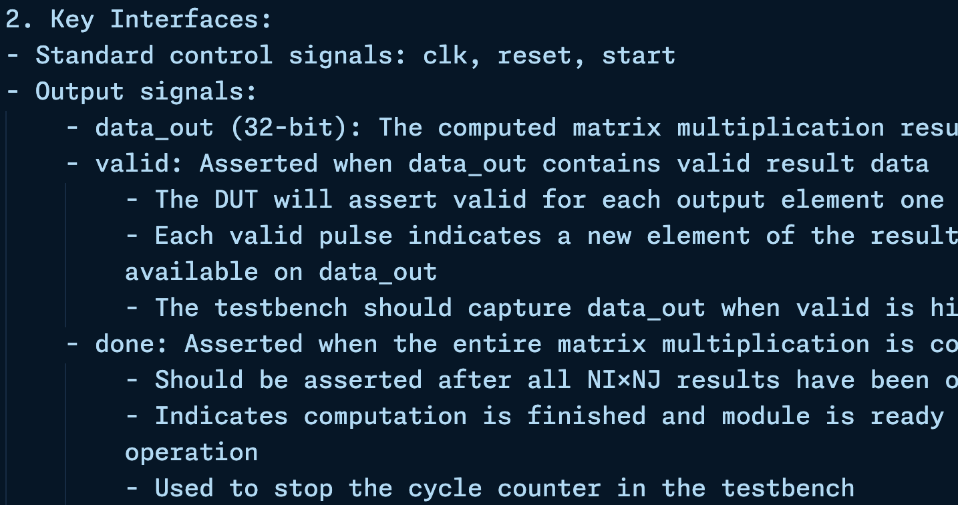
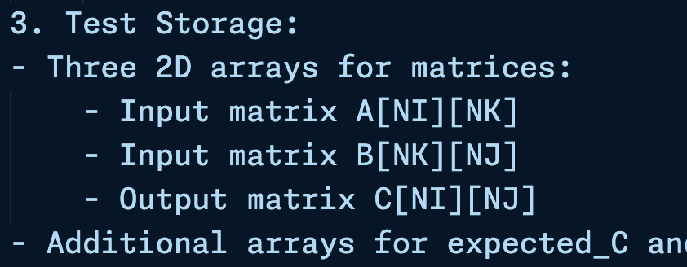
Testbench
Copy the prompt in 1.txt
Module Configuration, Key Interfaces and Test Storage in the prompt

Slide 130
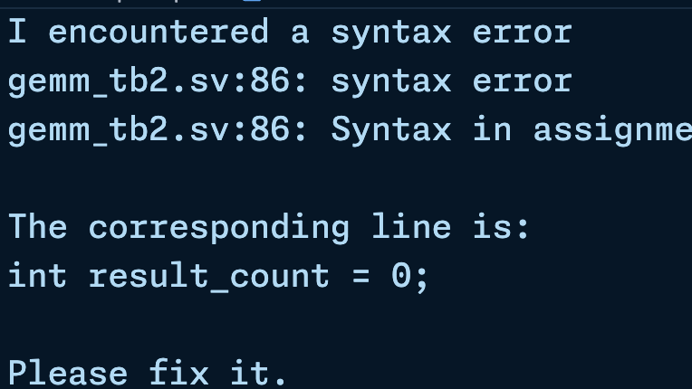
Testbench
Copy the LLM’s output to gemm_tb.sv
The result seems nice, but there is a syntax error
Let's see if the LLM can fix it.
(Copy the prompt in 2.txt)
touch $REPOS/origen/gemm/testbench/gemm_tb.sv

Slide 131
Testbench
Use iverilog to test again, we can find the error still exists.
To address this, we provide the LLM with the reason(Copy the prompt in 3.txt)
The revised code passes the syntax check and seems right.

Slide 132
Testbench
Next, we'll modify the testbench to generate hex files containing matrix data. (Copy the prompt in 4.txt)
Finally, we incorporate a timeout mechanism and a cycle counter into the testbench (using the prompt from 5.txt).

Slide 133
Kernel
To simplify the problem, we implement the kernel with combinational multiplier and memory first.
Compared to the testbench, the kernel's increased logical complexity needs more detailed prompts.
Copy the prompt in 1.txt

Slide 134
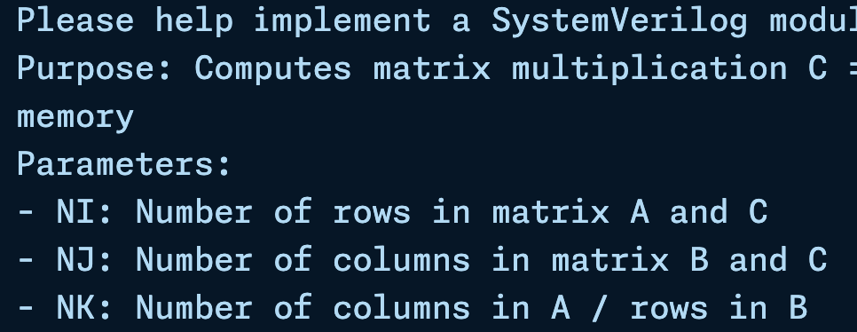
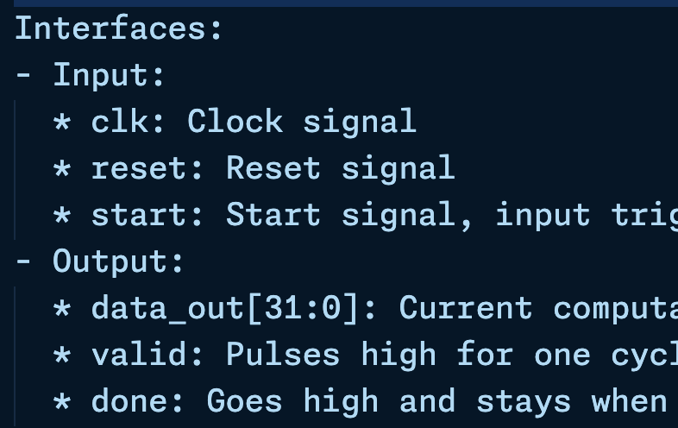
Kernel
Define the Configuration, Interfaces and Memory Requirements as testbench

Slide 135
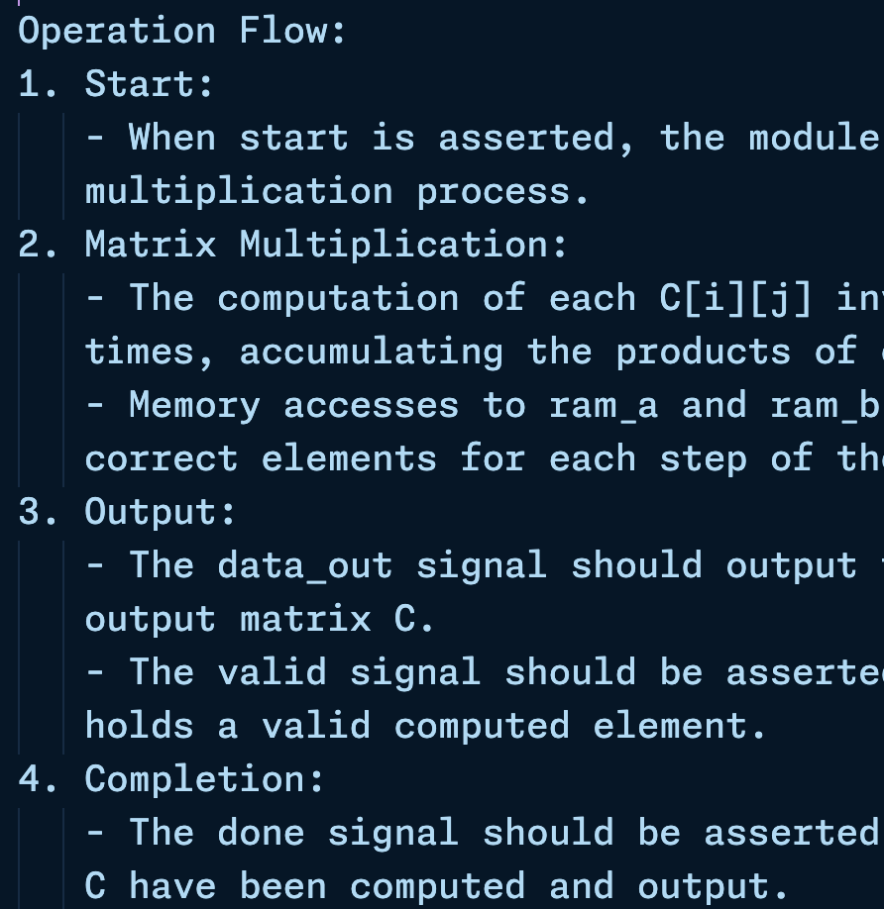
Kernel
Supplement details regrading the operation flow
Provide an overview of the code structure

Slide 136
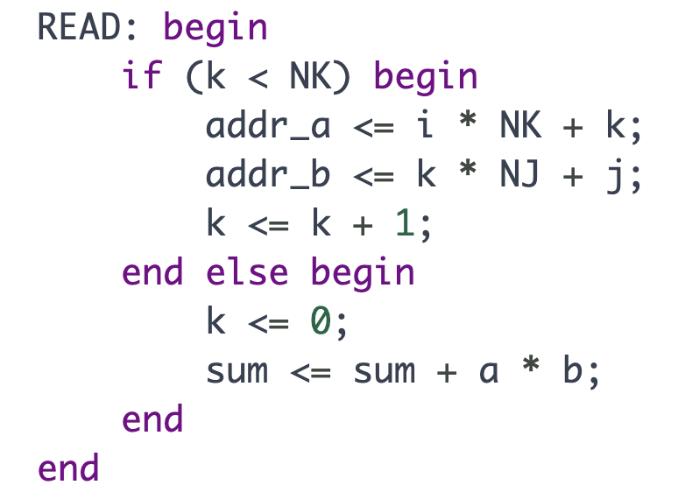
Kernel
Copy the LLM’s output to gemm.sv
The code structure appears good but has several main issues
READ state computes multiplication
touch $REPOS/origen/gemm/kernel/gemm.sv
State Machine Behavior Issue

Slide 137
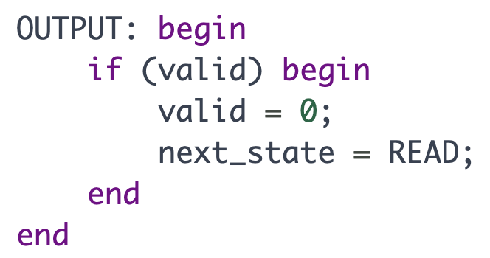
Kernel
valid is a register but is updated in an always_comb block
Assignment Issue

Slide 138
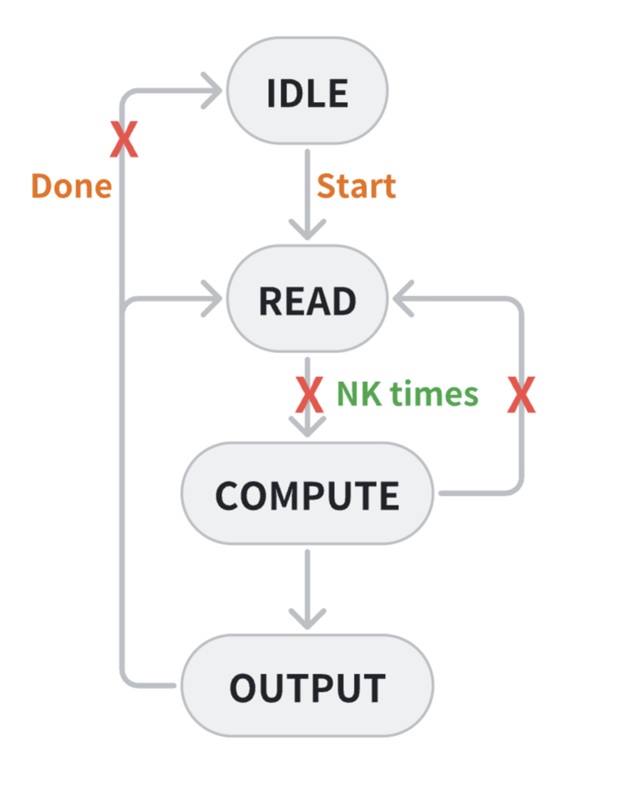
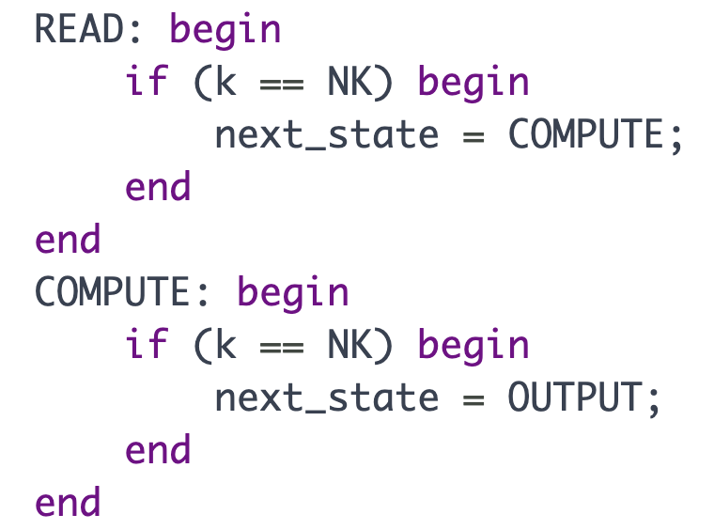
Kernel
The state transition logic for READ, COMPUTE,
and OUTPUT is incorrect.
State Machine Transition Issue

Slide 139
Kernel
Send the prompt in 2.txt to fix them
State Machine Behavior Issue
Assignment Issue
State Machine Transition Issue

Slide 140
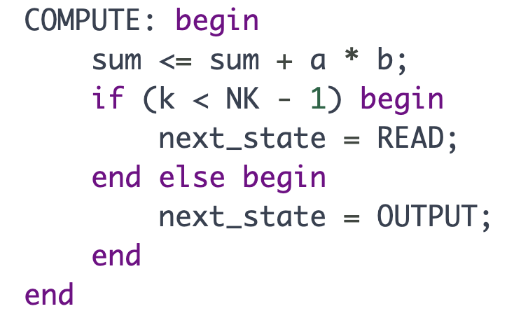
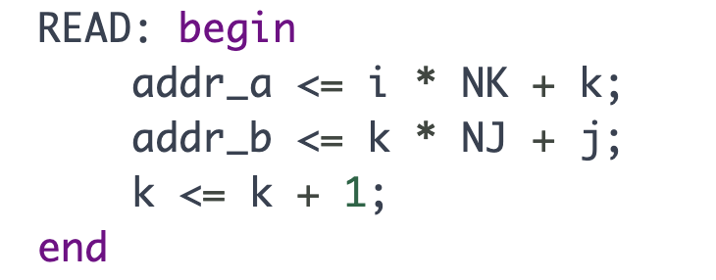
Kernel
Some are fixed, but new ones emerge.
While the state transition logic of COMPUTE is now correct, the assignment of next_state inside the always_ff block is incorrect.
The assignment k <= k + 1 within the READ state is incorrect. To resolve this, either modify the COMPUTE state's condition from k < NK - 1 to k < NK, or relocate k <= k + 1 to the COMPUTE state.
Assignment Issue
State Machine Transition Condition Issue

Slide 141
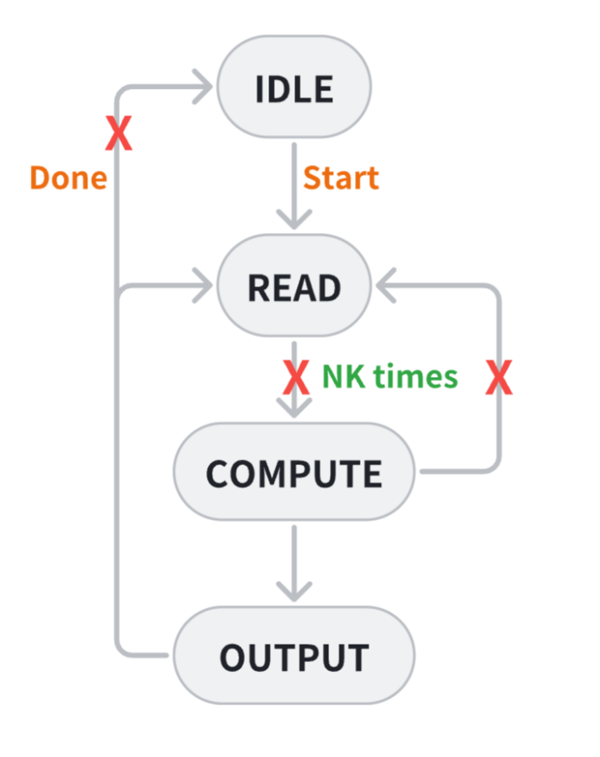
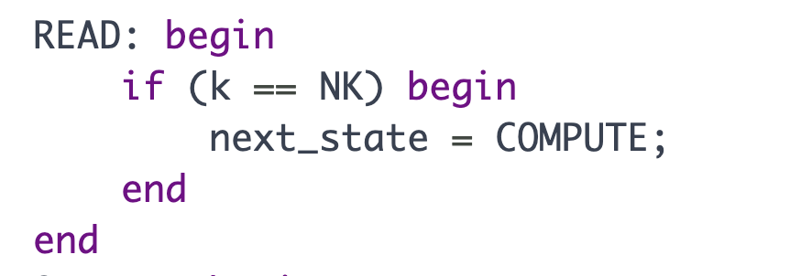
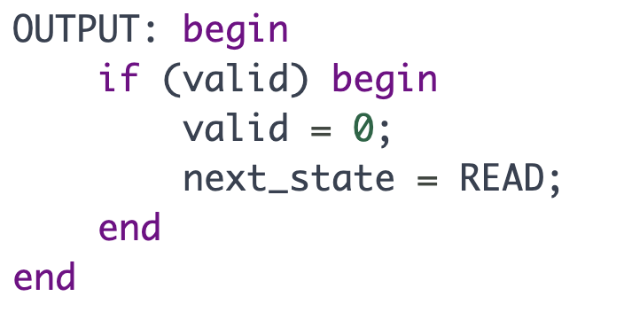
Kernel
The state transition logic for READ and OUTPUT is still incorrect.
Register is still updated in an always_comb block
State Machine Transition Issue
Assignment Issue

Slide 142
Kernel
Send the prompt in 3.txt to fix them
State Machine Transition Condition Issue
Assignment Issue

Slide 143
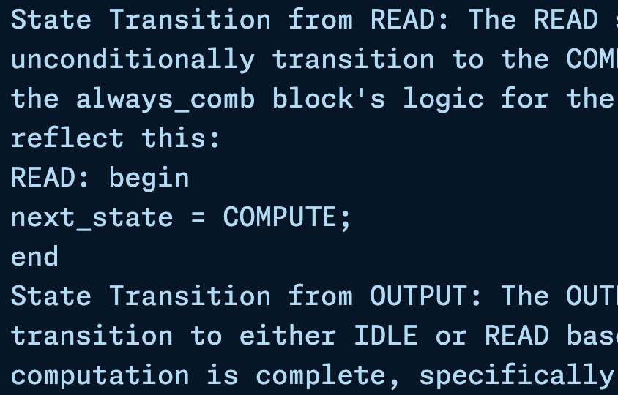
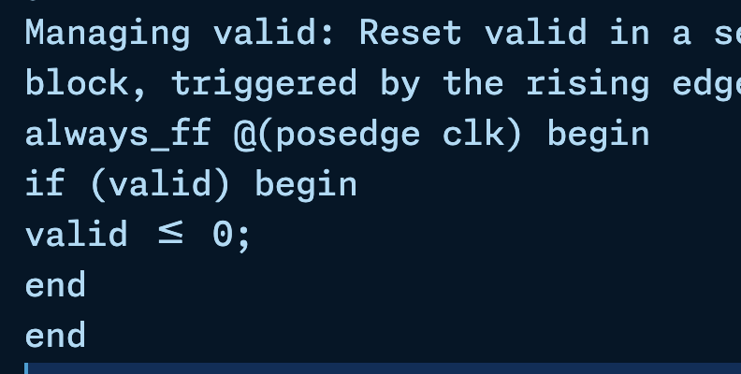
Kernel
Send the prompt in 3.txt to fix them
Providing reference code since the LLM didn’t fix them in the last attempt
State Machine Transition Issue
Assignment Issue

Slide 144
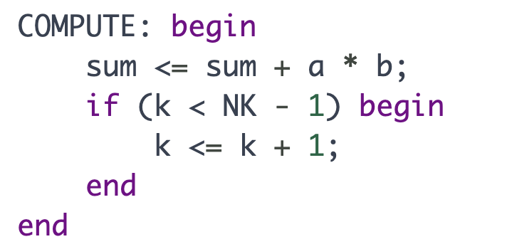
Kernel
The LLM has made progress, but there are still a few errors.
In COMPUTE state, it forgets to reset k to zero when k achieves NK - 1
State Machine Behavior Issue

Slide 145
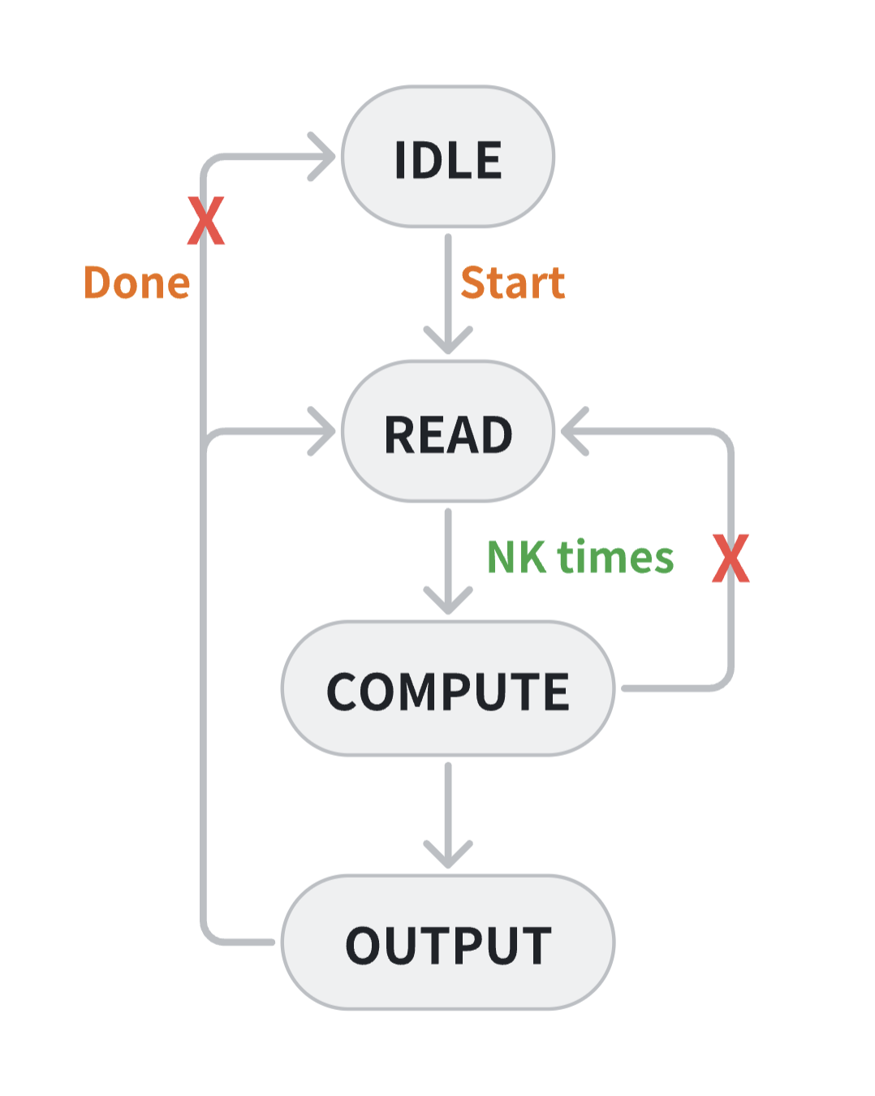
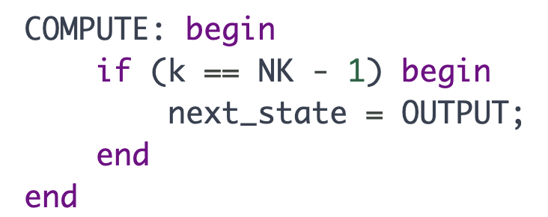
Kernel
In COMPUTE state, it forgets to return to READ state
In OUTPUT state, it should return to READ state directly instead of waiting valid to be true
State Machine Transition Issue

Slide 146
Kernel
State Machine Transition Issue
Send the prompt in 4.txt to fix them
Provide the reference code
State Machine Behavior Issue

Slide 147
Kernel
Now we can run testbench to test it
It passes the test!
It takes 1089 cycles
Average 2 cycles for each mac operation
cd $REPOS/origen/gemm
make gemm

Slide 148
Add Single-cycle Latency Multiplier
Next, we’ll add the single-cycle latency multiplier to the gemm kernel
Copy the prompt in 5.txt
Give the requirements and multiplier definition

Slide 149
Kernel
Seems good, it adds a MULTIPLY state to accommodate the latency
But it contains a silly error
It forgets to change the bit width
of state!

Slide 150
Kernel
Send the prompt in 6.txt to fix it
Now we can run testbench to test it
It takes 1601 cycles
Average 3 cycles for each
mac operation
cd $REPOS/origen/gemm
make gemm

Slide 151
Summary
Although the LLM may produce logic errors in the generated code, particularly in state machine.
LLMs demonstrate significant potential for accelerating hardware design.

Slide 152
Thank you for listening!

